Slide 1
A Whirlwind tour of (Hydroxy)Methylation Analysis

Slide 2
Outline
Intro to DNA methylation
Why and where
Assay
Hydroxymethylation
What and why
Assays (affinity, TAB-seq, OXBS-seq, RRHP)
An example OXBS-seq experiment
QC
Alignment
Quantitating
Modeling
An example RRHP experiment
Relating to gene expression?

Slide 3
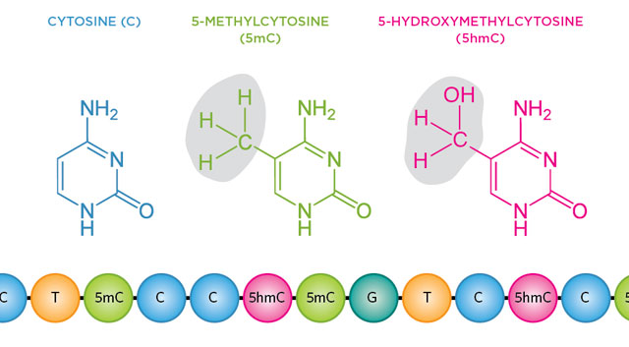
DNA methylation - why care?
Methylated CpGs are highly mutable but are still maintained
Chemically stable - covalent change, retained in cell division
Global hypomethylation observed in cancer
DNA methylation of repetitive elements prevents transposition
Affects/correlates with transcription
critical for imprinting and X-inactivation
CpG island methylation correlates with gene activity
May act as “chromatin state memory” during cell replication

Slide 4
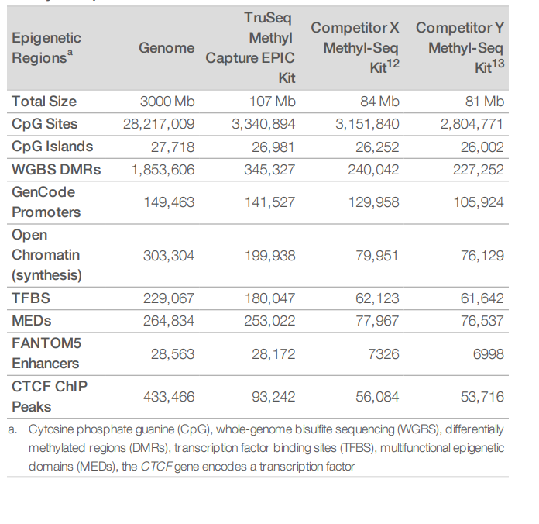
DNA methylation - genomic structure
~30 million sites within genome,
Underrepresented
majority (60-80%) methylated
CG (vast majority), CHG or CHH (where H correspond to A, T or C)
clustered upstream of TSS - CpG islands
CpG island methylation = lower transcription
Possibly by bulk hindrance of TFs?
~30000 within genome
Also found in gene bodies and enhancers
methylation of gene bodies can be associated with upregulated transcription
methylation can affect some TF bindings (eg. CTCF)
intragenic methylation is also associated with the use of alternative promoters or splice variants

Slide 5
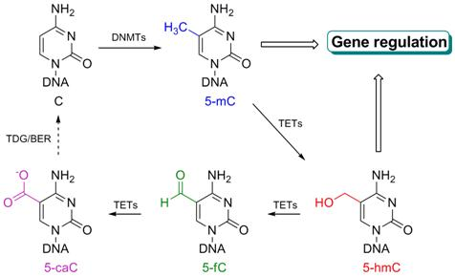
DNA hydroxymethylation
5-hydroxymethylcytosine
Formed by oxidation of 5mC by Tet enzymes
Part of demethylation pathway
Enriched in the brain, particularly neurons
Enriched in stems cells
Not only an intermediate in demethylation
thought to regulate transcription in its own right

Slide 6
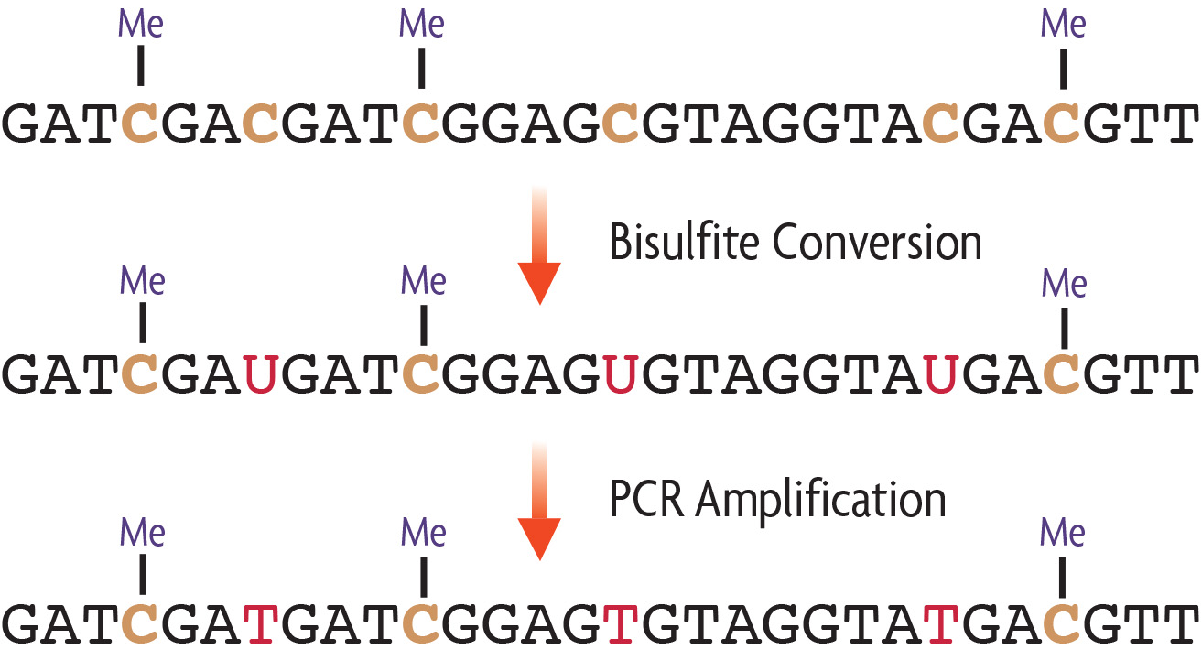
Assays - Bisulfite conversion

Slide 7
Assays - Bisulfite conversion
h
h
h

Slide 8
Assays
The Toolkit
Immunological
Antibodies (affinity based)
Enzymatic
MspI – cuts at CCGG
reduced representation (RRHP)
Tet oxidation (TAB-seq, affinity)
Chemical
Oxidation of 5hMC (OXBS-seq)
Glucosylation of 5hMC (RRHP, TAB-seq, affinity)
Bisulfite conversion of 5MC and 5hMC (OXBS-seq, TAB-seq, affinity)
Assay targets
Whole genome
Expensive
Reduced representation
Target regions enriched for CpGs
Cheaper but incomplete
Enzymatic:
MspI cuts at CCGG
Size select fragments
More incomplete, messy, double stranded possible
Pulldown
Exome-style
Complete, clean, single strand only
Resolution
Regional - affinity
Single base – bisulfite methods

Slide 9
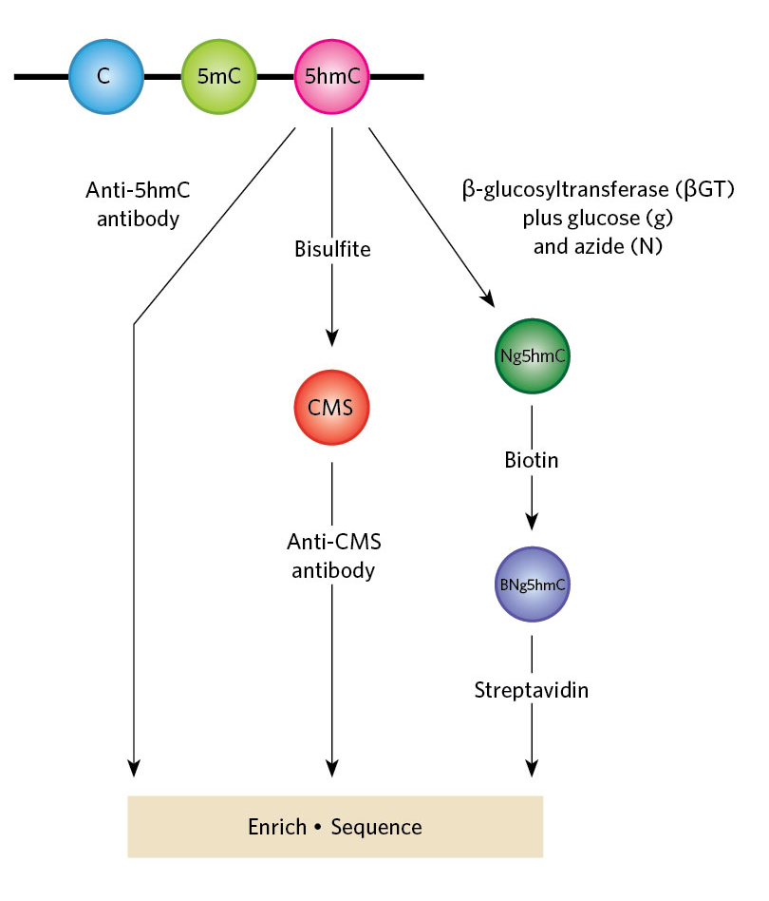
Assays - Affinity based profiling
“hMeDIP-seq”
Either direct pulldown or via chemical conversion labelling intermediary
CMS = cytosine-5-methylenesulfonate
Highly immunogenic
biased towards highly hydroxymethylated regions
Ficz et al. Dynamic regulation of 5-hydroxymethylcytosine in mouse ES cells and during differentiation. Nature. 2011 May 19;473(7347):398-402.

Slide 10
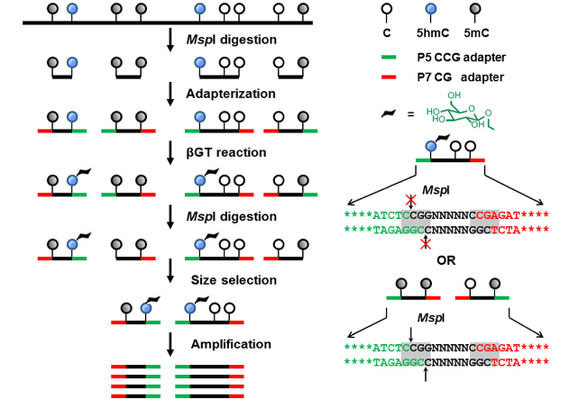
RRHP
Reduced Representation Hydroxymethylation Profiling
“MspI protection assay”
Cheap
Semi-quantitative
Petterson et al. RRHP: a tag-based approach for 5-hydroxymethylcytosine mapping at single-site resolution. Genome Biol. 2014 Sep 24;15(9):456.

Slide 11
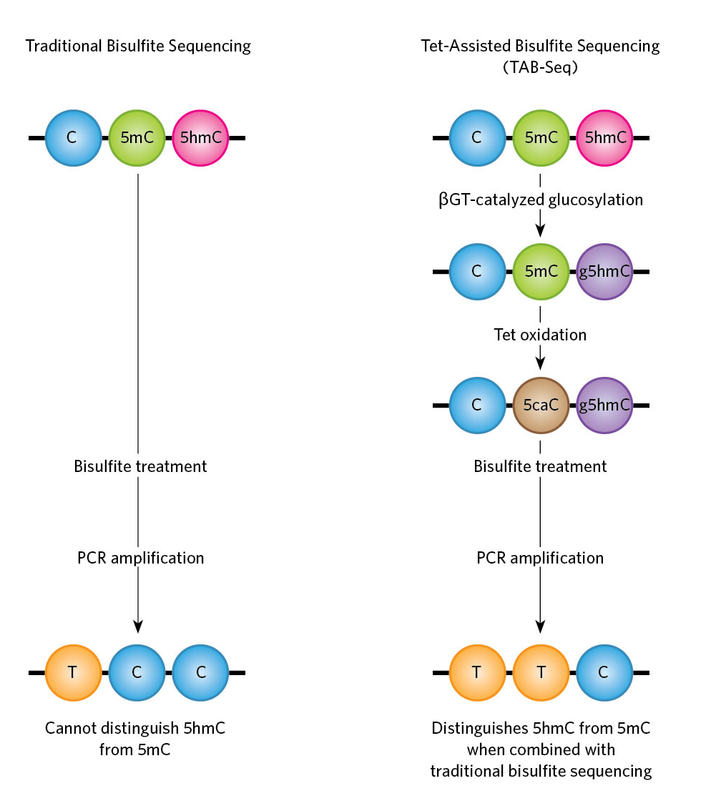
Assays - TAB-seq
Tet-assisted bisulfite sequencing
Can only know 5mC levels by subtraction
good if you only want 5hMC levels
expensive
Yu et al.. Base-resolution analysis of 5-hydroxymethylcytosine in the mammalian genome. Cell. 2012 Jun 8;149(6):1368-80

Slide 12
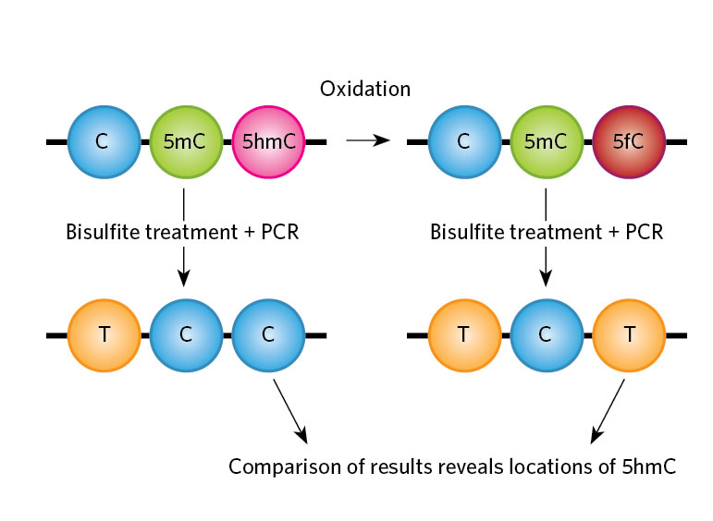
Assays - OXBS-seq
Oxidative bisulfite treatment
Can only know 5hMC levels by subtraction
bisulfite seq and oxidative bisulfite seq done in parallel on same sample
expensive
Booth et al. Oxidative bisulfite sequencing of 5-methylcytosine and 5-hydroxymethylcytosine. Nat Protoc. 2013 Oct;8(10):1841-51

Slide 13
An OXBS-seq experiment
Whole genome OXBS-seq
Occiptal and frontal lobe material from controls and Alzheimer’s patients
Run with CEGX Trumethyl kit
Fetahu IS, Ma D, Rabidou K, Argueta C, Smith M, Liu H, Wu F, Shi YG. Epigenetic signatures of methylated DNA cytosine in Alzheimer's disease.
Sci Adv. 2019 Aug 28;5(8):eaaw2880.

Slide 14
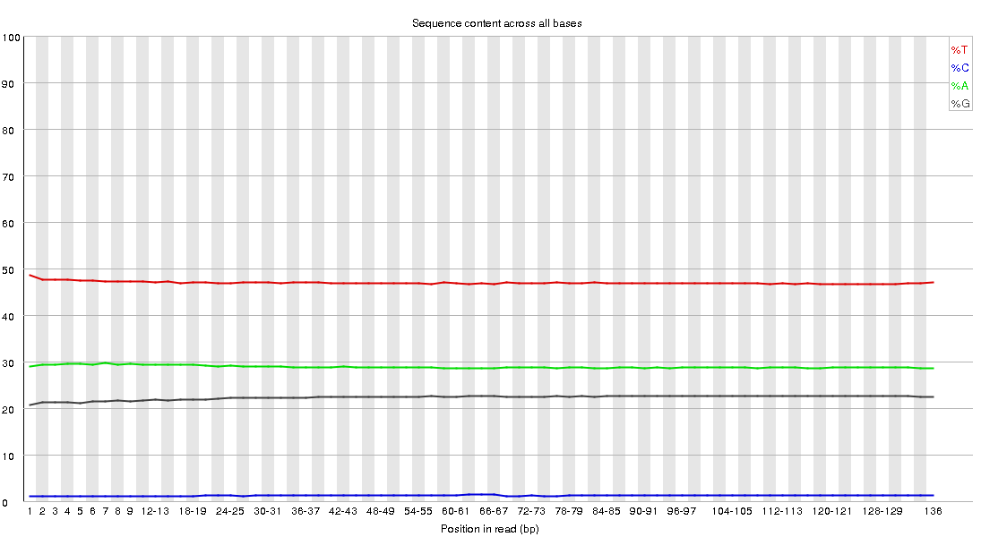
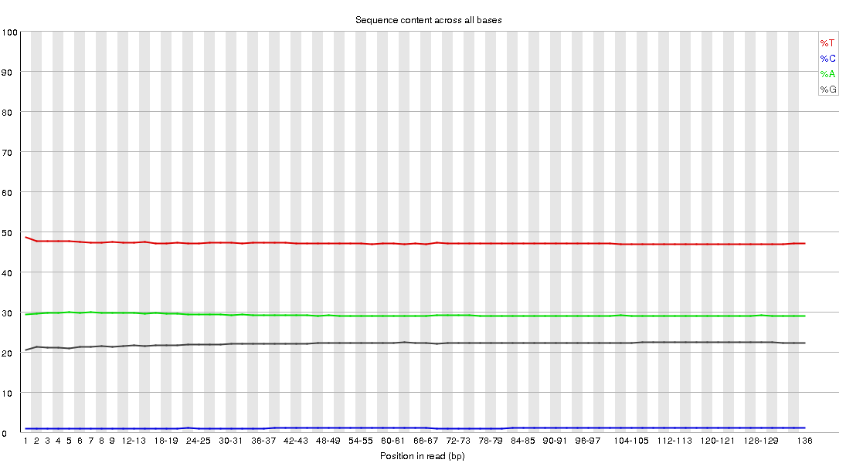
Quality metrics – base sequence content
OXBS-seq
Bisulfite
Oxy-bisulfite

Slide 15
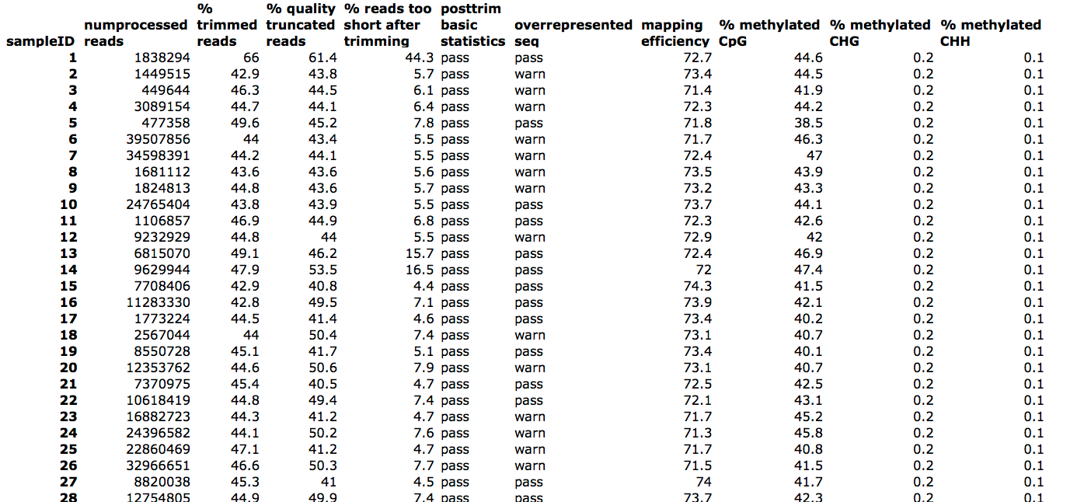
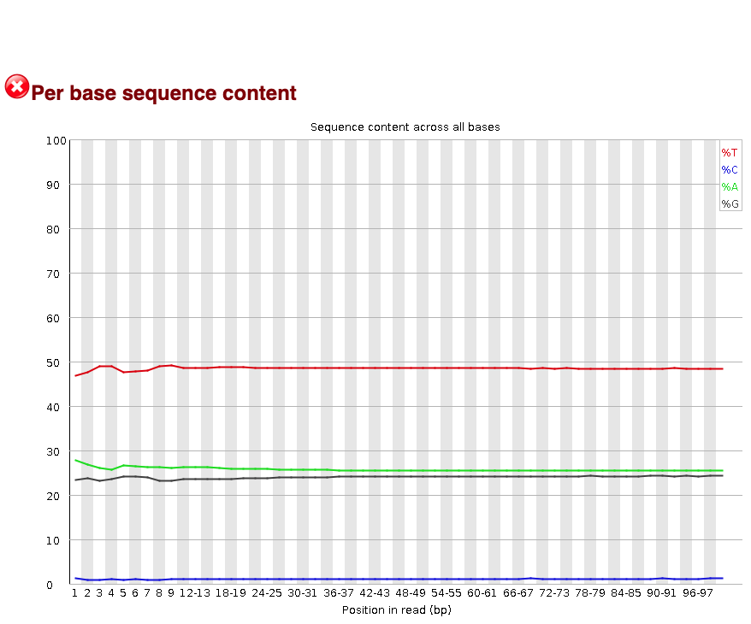
Quality metrics - bisulfite conversion rate
OXBS-seq
Low CHH and CHB methylation
low cytosine content on OT strand

Slide 16
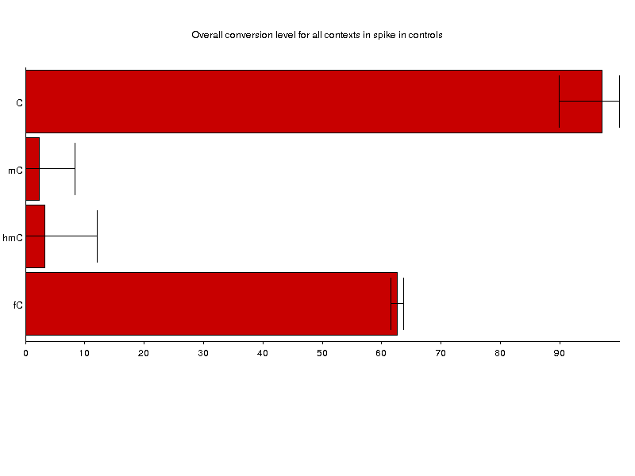
CEGX controls – conversion
OXBS-seq
Bisulfite
Oxy-bisulfite

Slide 17
Preprocessing - trimming
OXBS-seq
Usual reasons to trim
Remove adapters
Remove low quality sequences
Remove primer biased sequences
Novel reasons to trim
5` bisulfite conversion failure bias
M-bias plots can help diagnose issues

Slide 18
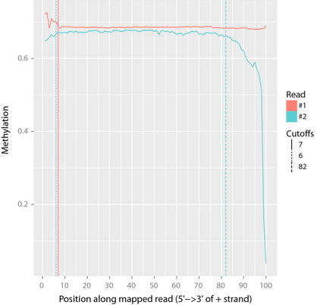
M-bias plots
OXBS-seq
Expect consistent methylation levels regardless of base position on read

Slide 19
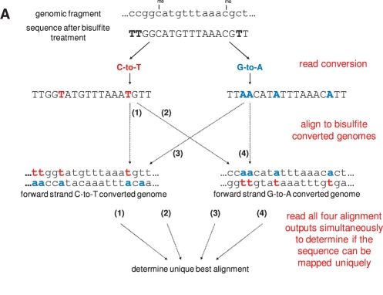
Alignment
OXBS-seq

Slide 20
Choice of Aligner
OXBS-seq
Bismark
Standard used in field
Slower but accurate
Well supported
Best compromise of accuracy, coverage and speed
BSmap
Higher mapping percentage
Faster
Lower coverage in bakeoffs
Didn’t handle paired reads well in our hands
Ignored outer-inner read parameters, mapping percentage dropped to Bismark‘s when filtered

Slide 21
Summarized alignment data
OXBS-seq
chr | start | end | perc | C | T
1 | 10470 | 10470 | 100 | 1 | 0
1 | 10472 | 10472 | 0 | 0 | 1
1 | 10485 | 10485 | 50 | 1 | 1
1 | 10490 | 10490 | 100 | 2 | 0
1 | 10494 | 10494 | 100 | 2 | 0
1 | 10498 | 10498 | 100 | 2 | 0
1 | 10526 | 10526 | 67 | 2 | 1
1 | 10543 | 10543 | 100 | 3 | 0
1 | 10564 | 10564 | 100 | 3 | 0
1 | 10572 | 10572 | 100 | 3 | 0
1 | 10578 | 10578 | 100 | 3 | 0
1 | 10580 | 10580 | 100 | 3 | 0
1 | 10590 | 10590 | 100 | 3 | 0
1 | 13417 | 13417 | 0 | 0 | 1
1 | 13644 | 13644 | 100 | 1 | 0
1 | 15749 | 15749 | 100 | 1 | 0
1 | 15769 | 15769 | 100 | 1 | 0
1 | 15789 | 15789 | 100 | 1 | 0
1 | 15912 | 15912 | 100 | 1 | 0
1 | 16059 | 16059 | 75 | 3 | 1
1 | 16071 | 16071 | 80 | 4 | 1
1 | 16083 | 16083 | 100 | 7 | 0
1 | 16140 | 16140 | 93 | 25 | 2
1 | 16142 | 16142 | 93 | 26 | 2
1 | 16243 | 16243 | 0 | 0 | 1
1 | 16244 | 16244 | 73 | 19 | 7
1 | 17379 | 17379 | 100 | 1 | 0
1 | 17407 | 17407 | 100 | 1 | 0
1 | 17452 | 17452 | 100 | 1 | 0
1 | 17453 | 17453 | 100 | 5 | 0
1 | 17478 | 17478 | 100 | 1 | 0
1 | 17479 | 17479 | 67 | 4 | 2
Readout is:
Number of C’s (unconverted)
Number of T’s (converted)
Methylation level is a ratio of unconverted C’s over total reads
“Cytosine ratio”
C/(C+T)
“Beta value”
Beta is sometimes logit transformed for modeling
Log2(C/T)
“M value”

Slide 22
Measuring hydroxymethylation
OXBS-seq
To find the levels of hydroxymethylation:
BS = 5mC + 5hMC
OXBS = 5mC
(bisulfite cytosine ratio) - (oxybisulfite cytosine ratio)

Slide 23
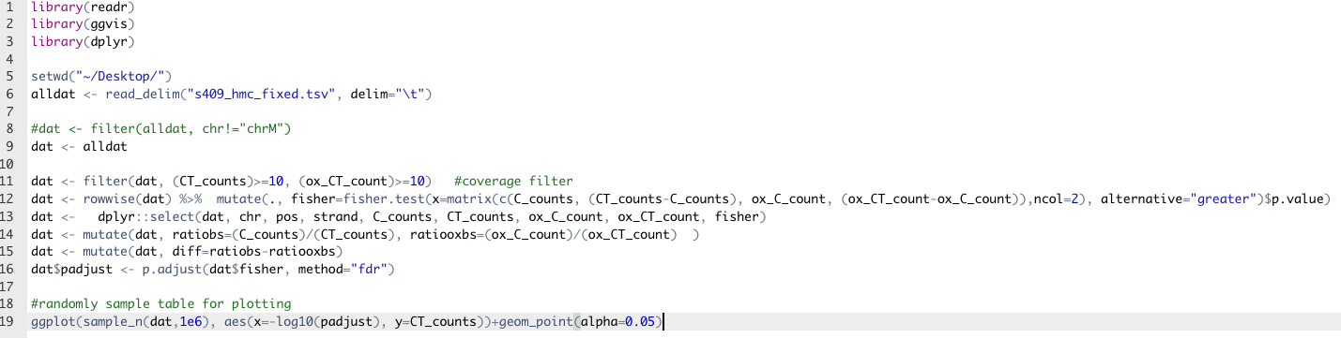
Measuring hydroxymethylation – our first pass
OXBS-seq
Filter for >10 read coverage in both samples
Used ratio subtraction to measure 5hMC levels
Used Fisher’s exact test to test if ratios significantly different

Slide 24
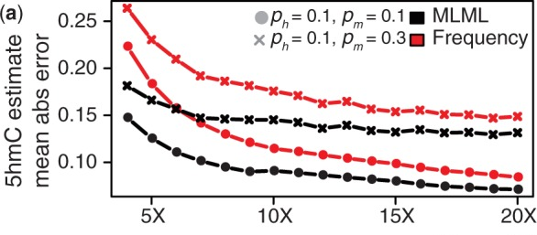
Measuring hydroxymethylation – better method
OXBS-seq
Subtraction of ratios can give negative numbers (”overshoot”)
doesn’t account for varying read depth in assays!
In an OXBS-seq dataset - 17% of CpG sites captured by RRBS and oxRRBS experiments exhibited “overshoot”
MLML - maximum likelihood methylation levels
estimate the % of mC, hmC and un-methylated for each site
gives a confidence value that can help discard problematic sites
Improved error rate at low coverage
Qu et al. MLML: consistent simultaneous estimates of DNA methylation and hydroxymethylation. Bioinformatics. 2013 Oct 15;29(20):2645-6

Slide 25
Measuring hydroxymethylation – number of sites
OXBS-seq
Client expected ~4% of CpG sites to be “hydroxymethylated”
How do you define a “hydroxymethylated” site?
Any particular CpG cytosine in the data can be a mixture of
Unmethylated,
Methylated
Hydroxymethylated
Neither bisulfite or oxidative treatment are 100% effective
Cutoffs were informed by control probes included in assay
>0.7 cytosine ratio in the OX-Bsseq assay (low end of conversion rate of 5hMC sites)
>0.3 difference in cytosine ratios between bisulfite and OX-bisulfite assays
(i.e. majority 5hMC)
OXBS-seq
BS-seq

Slide 26
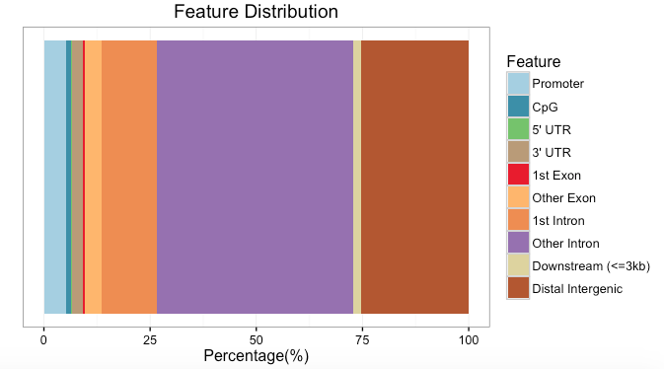
OXBS-seq
Measuring hydroxymethylation – number of sites
Number of hmC: 38639
Number of mC: 2845193
hmC = 1.339849 % of the total methylated

Slide 27
Statistical models – incorporating replicates
OXBS-seq
linear regression of ratio ~ x.
100 reads cover a nucleotide is not statistically equivalent to the case when 2 reads cover a nucleotide
glm() function in R with the binomial distribution with weights representing the covering reads.
https://mikelove.wordpress.com/2013/09/02/binomial-glm-for-ratios-of-read-counts/
How to weight when we have two assays?
Conservative
- minimum number of reads between the assays
Liberal
- Mean number of reads between the assays
https://mikelove.wordpress.com/2013/09/02/binomial-glm-for-ratios-of-read-counts/

Slide 28
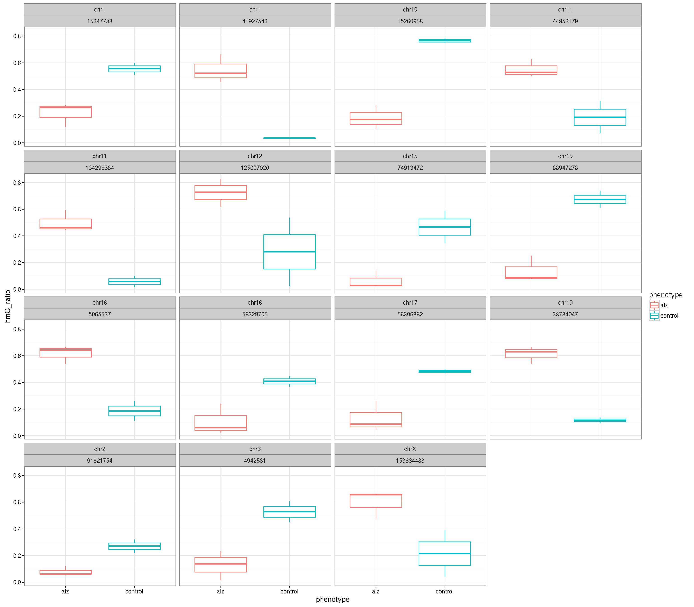
OXBS-seq
5400 sites that show an adjusted p.value of less than 0.05.

Slide 29
RRHP
Reduced Representation Hydroxymethylation Profiling
“MspI protection assay”
cheap
Petterson et al. RRHP: a tag-based approach for 5-hydroxymethylcytosine mapping at single-site resolution. Genome Biol. 2014 Sep 24;15(9):456.

Slide 30

RRHP experiment
RRHP after Tet2 knockdown in primary corneal epithelium line
RRHP was single replicate
Run in parallel with 3 replicates of RNA-seq
Run and processed by Zymo
used their counts (and annotations when available)
.

Slide 31
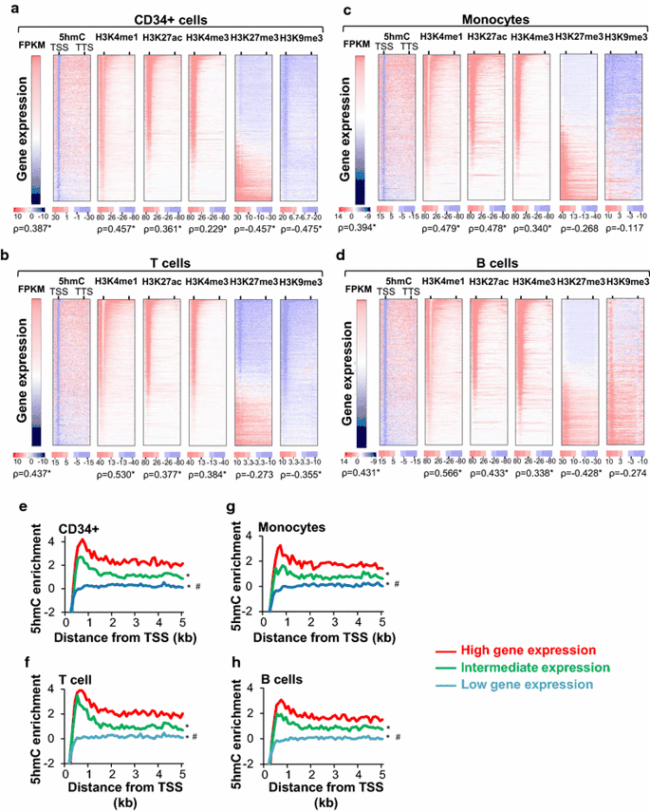
Correlating RRHP results to gene expression levels
RRHP
Tekpli et al. Changes of 5-hydroxymethylcytosine distribution during myeloid and lymphoid differentiation of CD34+ cells. Epigenetics Chromatin. 2016 May 31;9:21.

Slide 32
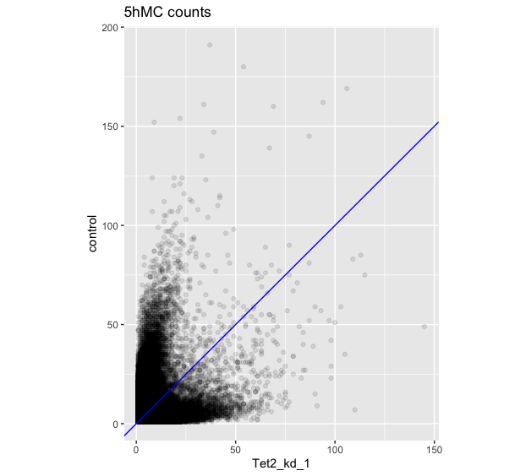
Effects of Tet2 kd on 5hMC levels in corneal epithelium

Slide 33
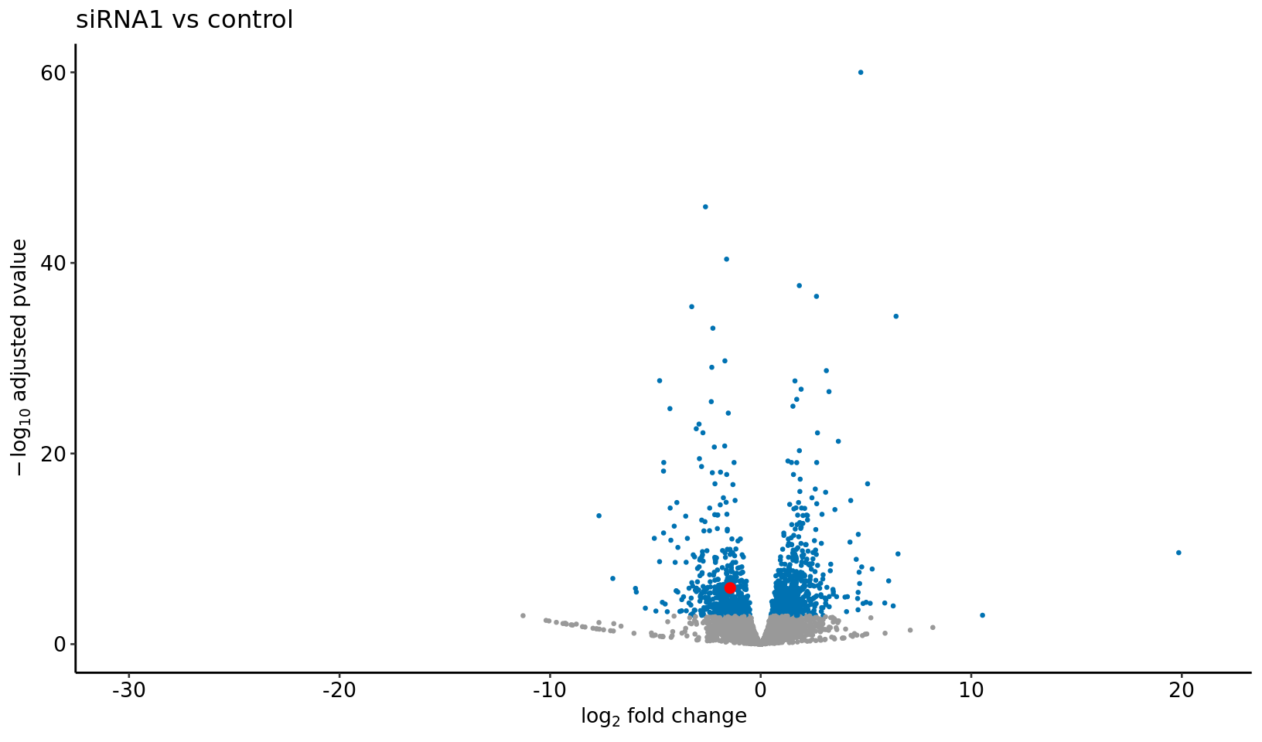
Differential Expression in Tet2 knockdowns

Slide 34
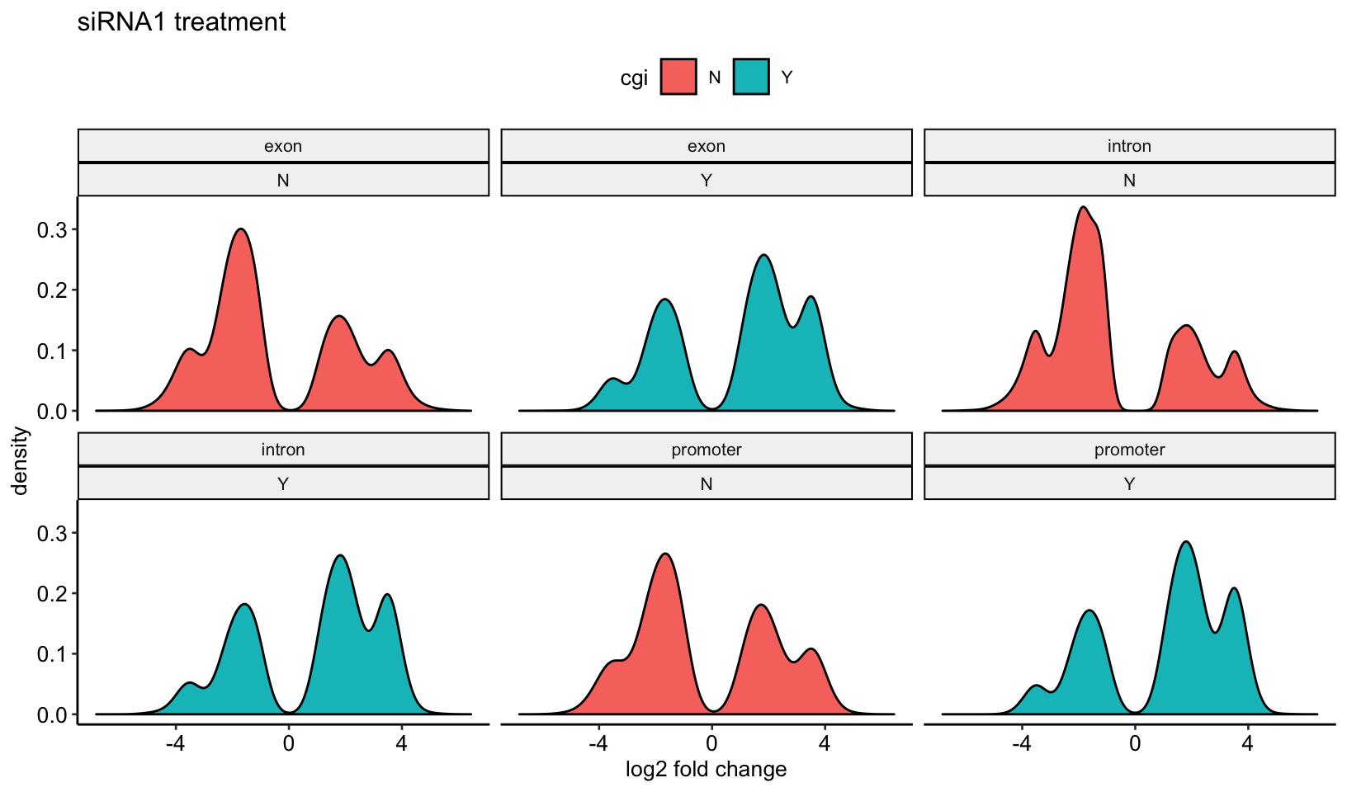
Genomic context of 5hMC changes

Slide 35
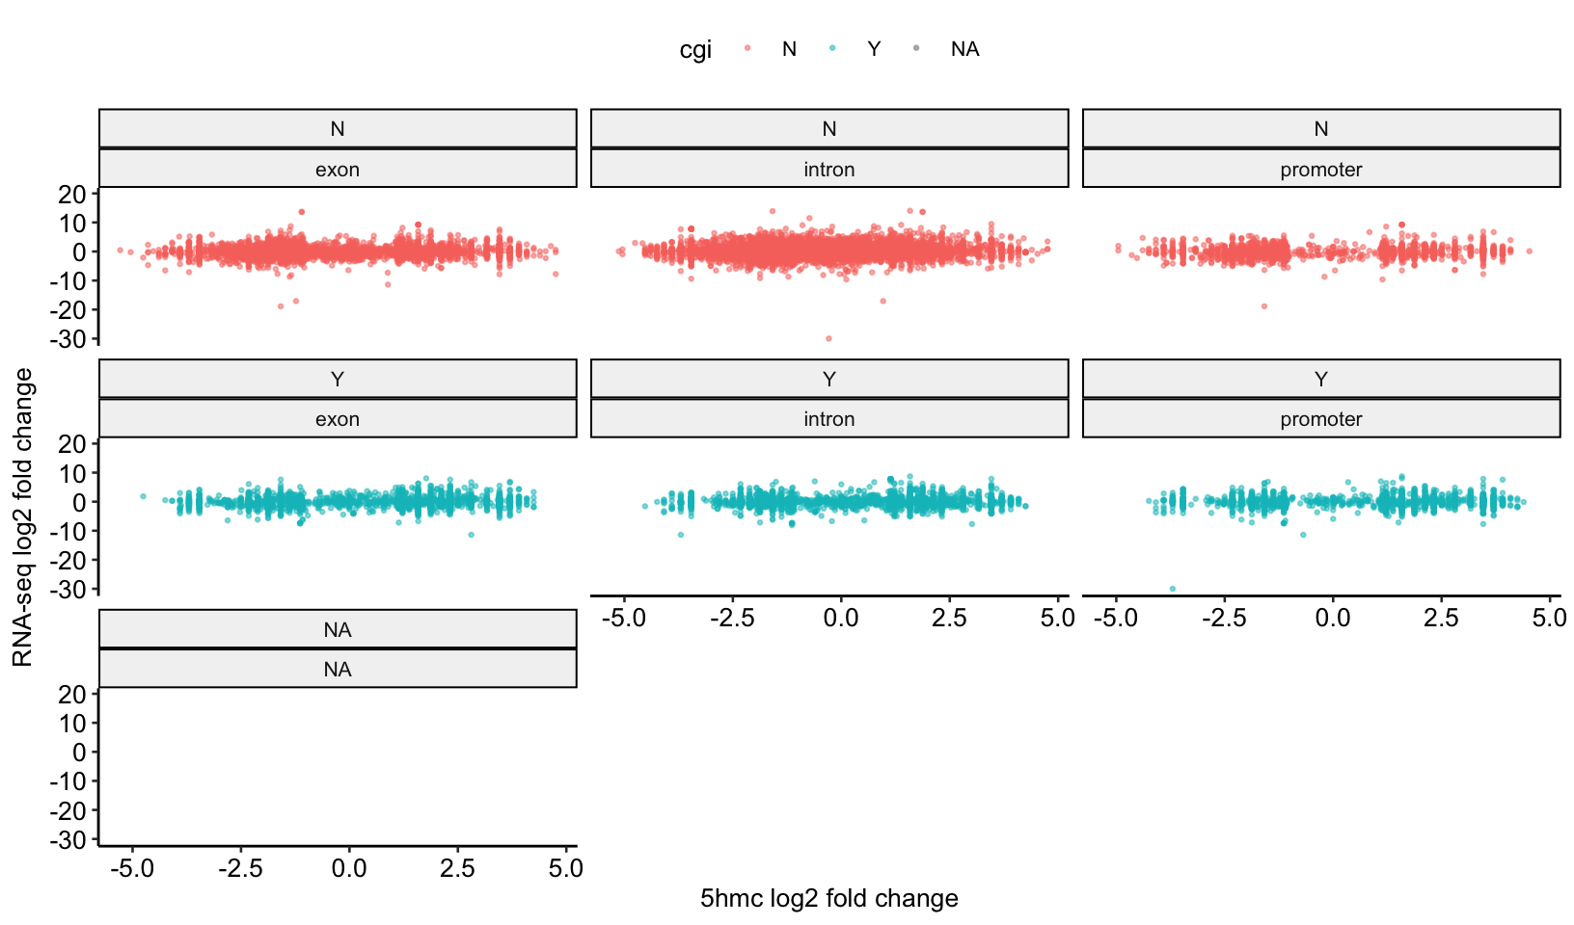
5hMC change versus gene expression changes

Slide 36
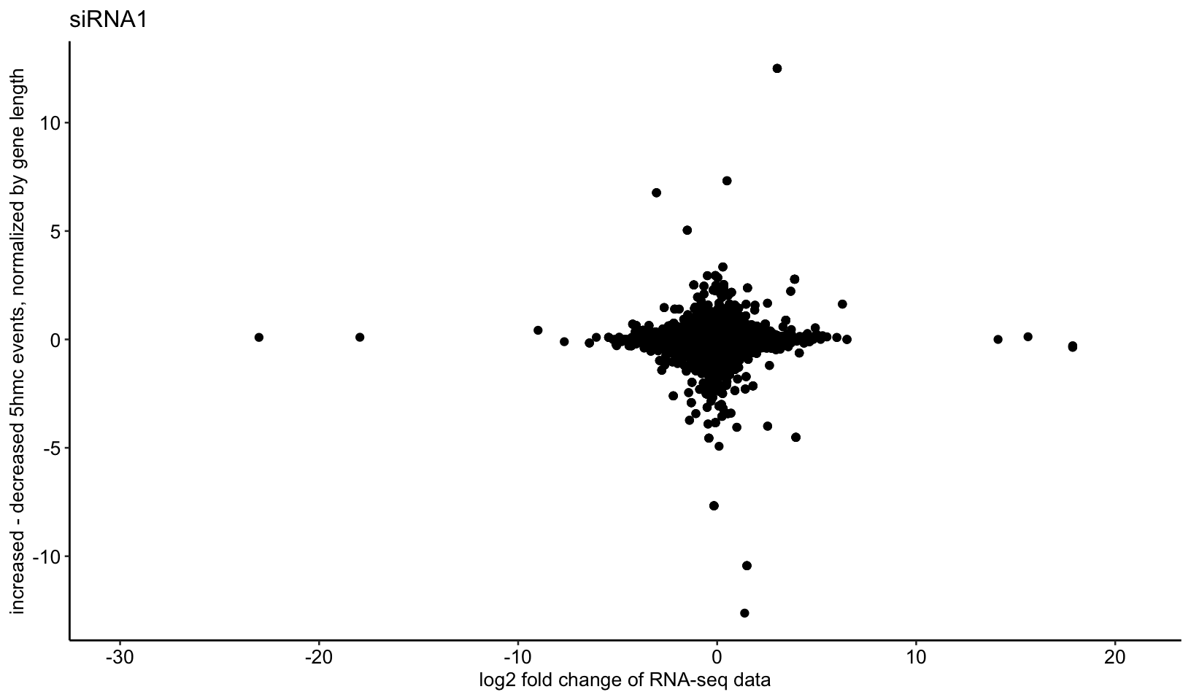
Regularized and bias adjusted 5hMC change versus expression change

Slide 37
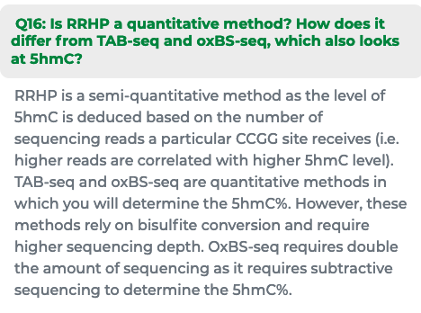
…from the Zymo RRHP FAQ

Slide 38
RRHP – future plans
Convince the researcher to run replicate samples
See if subsets of DE genes associated with different 5hMC changes are enriched in certain functional classes
Abandon entirely and get them to run TAB-seq or RRTAB-seq

Slide 39
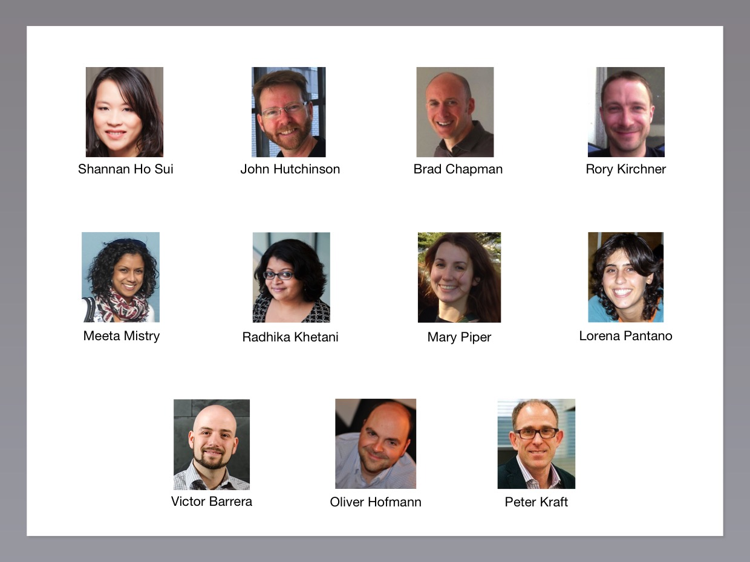
Acknowledgements
OXBS-seq work
RRHP work
Harvard NeuroDiscovery Center
Shi Lab
Yujiang Shi
Ira Fetahu
Feizhen Wu
Dingaliu Ma
Harvard Stem Cell Institute
Frank Lab
Natasha Frank
Lynn Guo
Jiang Yusheng

Slide 43
Working with the summarized data
Many different packages in R/bioC for working with bisulfite data
MethyKit is a suite of tools that does just about everything (though poorly)
Most of the other packages will accept the bsseq format (bsseq BioC package)
Bsseq::read.bismark - read in Bismark formatted data of different types ( I like the CpG report as it has strand info)
Working with 30 million CpGs is difficult and wasteful as many loci have no coverage in any samples
can pre-specify regions/loci or let bsseq find them (this takes longer)
Some packages have disk based objects for access
Parallelization options

Slide 44
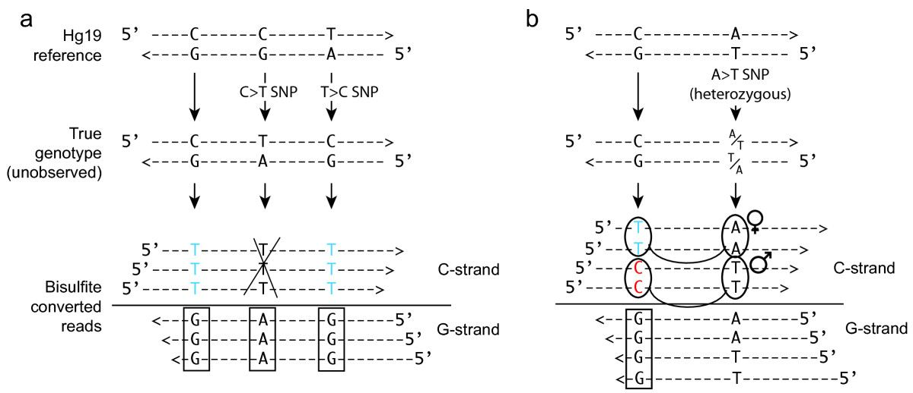
SNPs
BIS-SNP
Bismark aligns to a reference genome
C/T SNPs (common mutations after methylated cytosine deamination events) can look like de-methylation events
Bis-SNP
Combined DNA methylation and SNP calling for Bisulfite-seq data
Require double stranded data (not all methylation assays have this!)

Slide 45
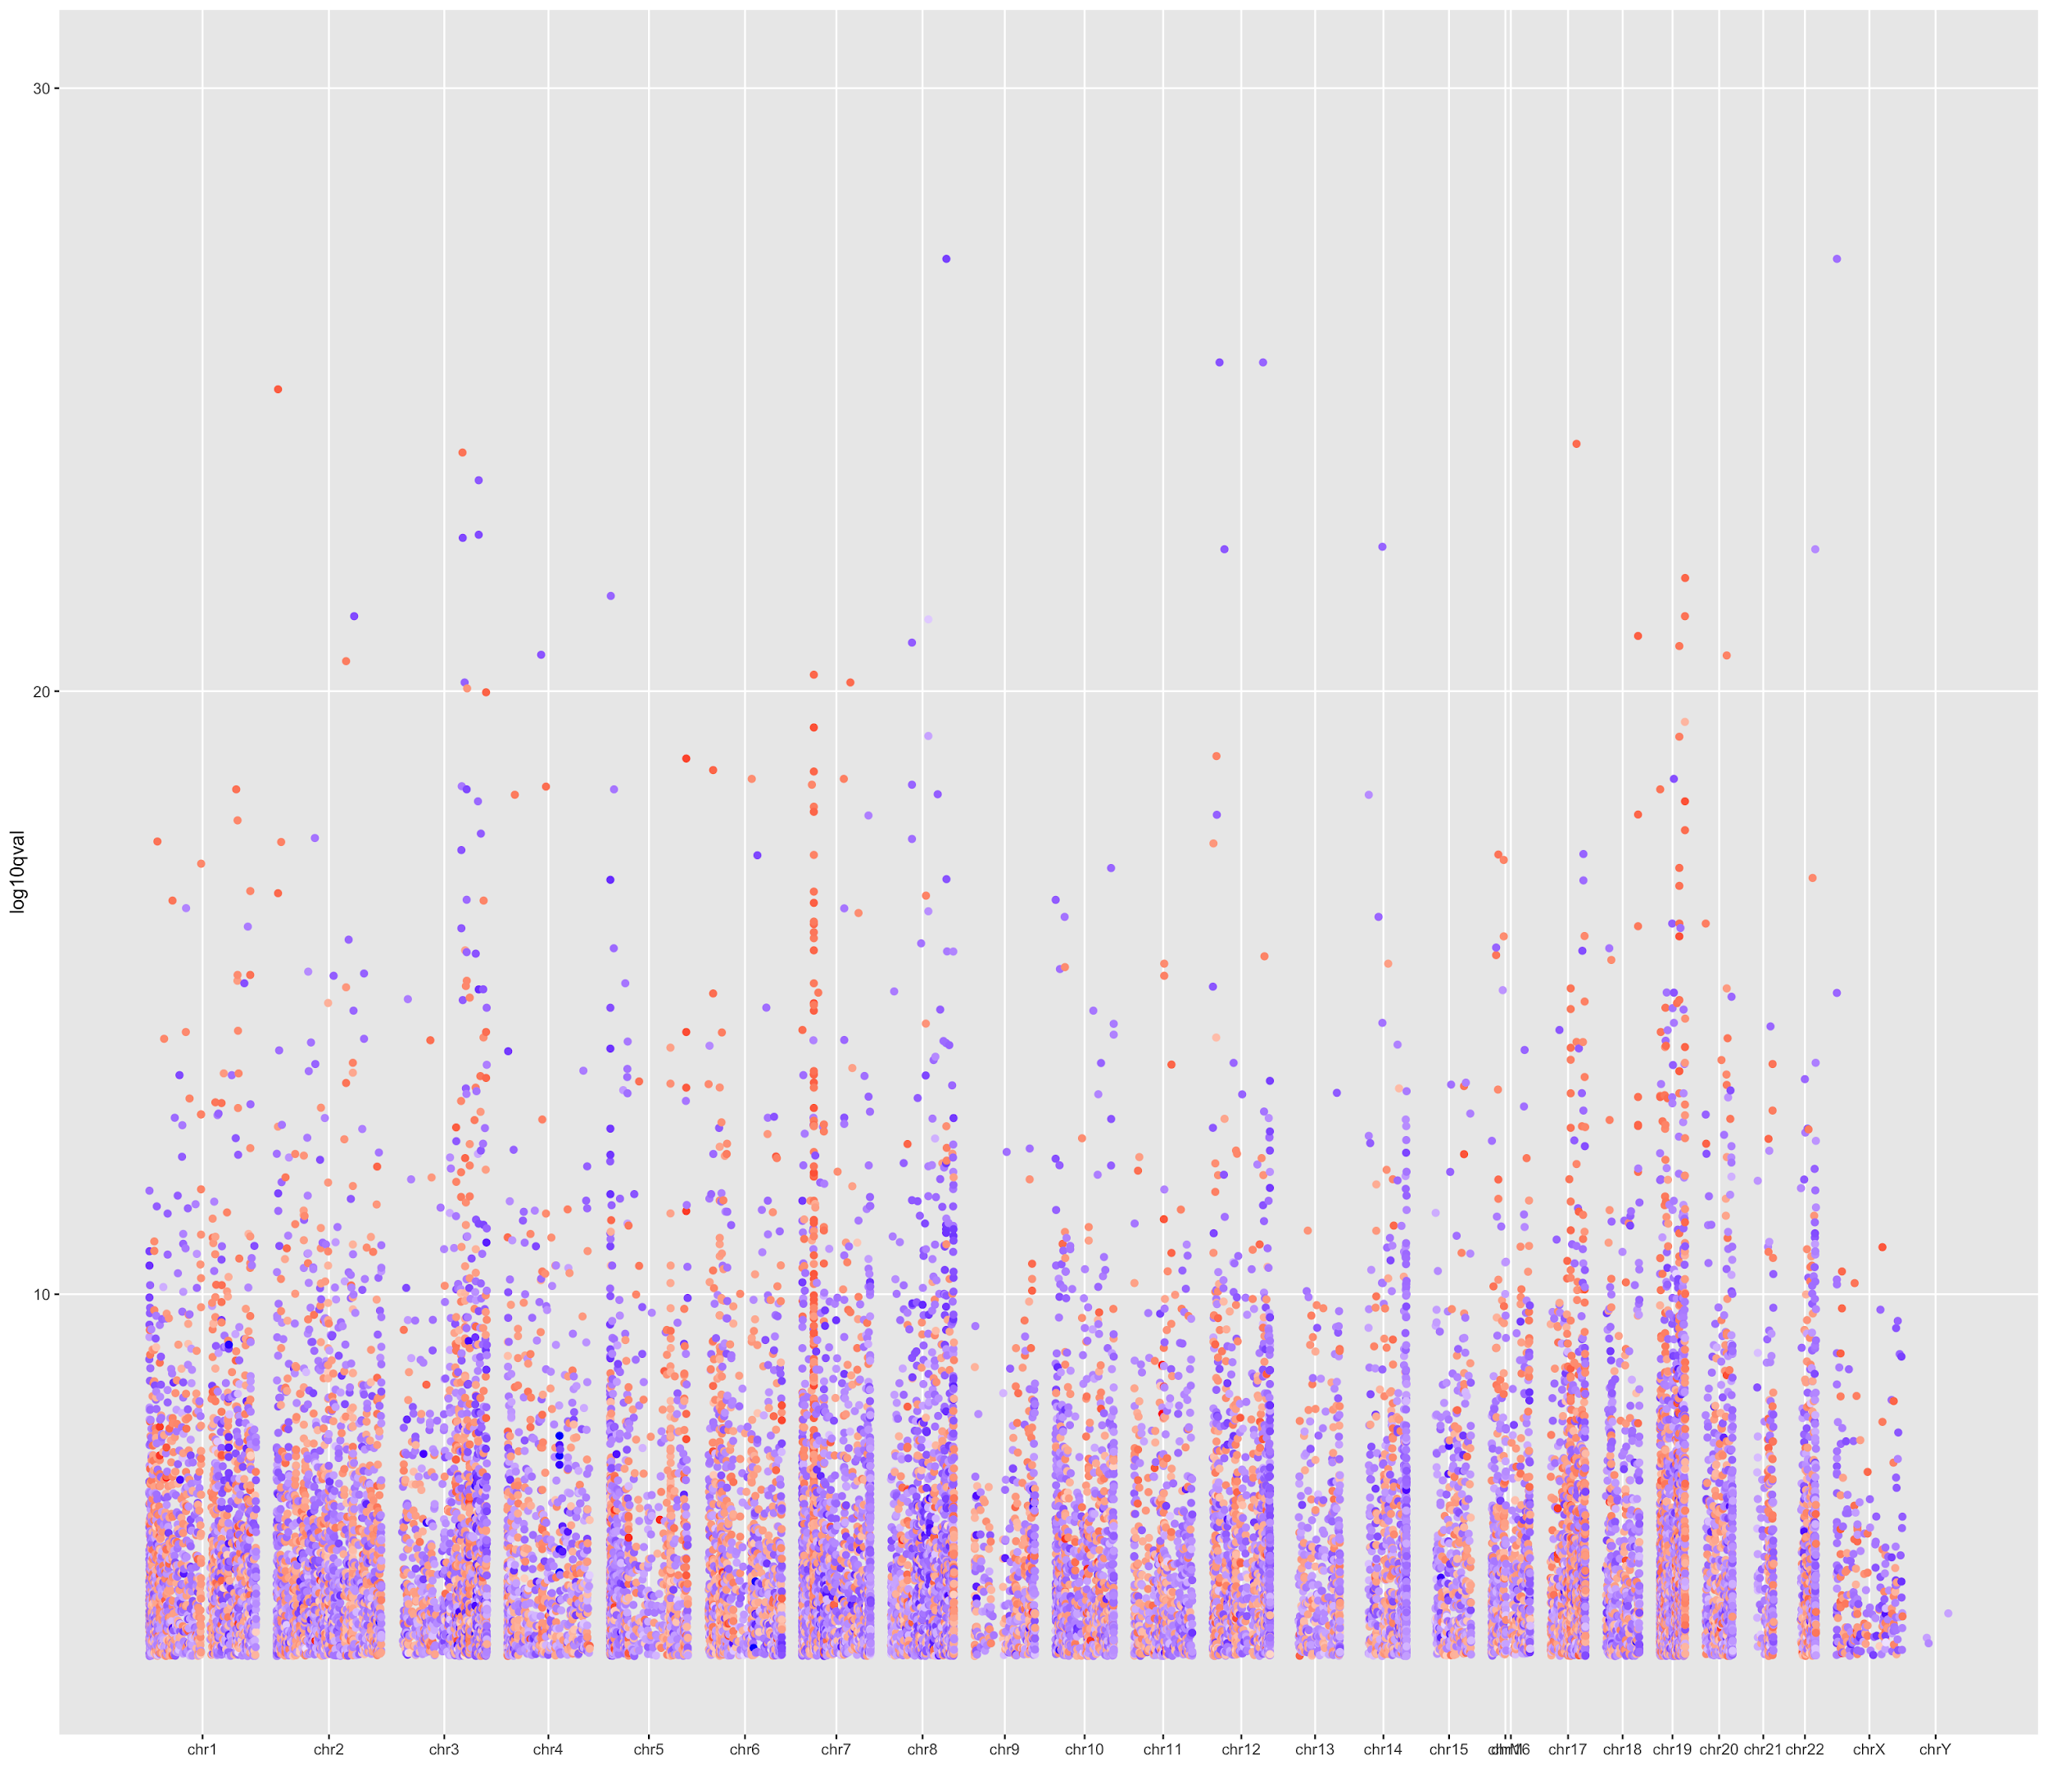
DMRs versus DMLs
DMLs = Differentially Methylation Loci
Pros
Won’t miss smaller signals
Easy to measure
Cons
High multiple testing correction penalty
There can be millions of hits
Redundant information
Role of single DML often unclear
Can be a SNP artefact
DMRs = Differentially Methylated Regions
Signals often cluster, particularly in CpG islands
Pros
Low multiple testing penalty
Easier to interpret
Less likely to be artefact
Cons
Can miss smaller signals
How to measure?

Slide 46
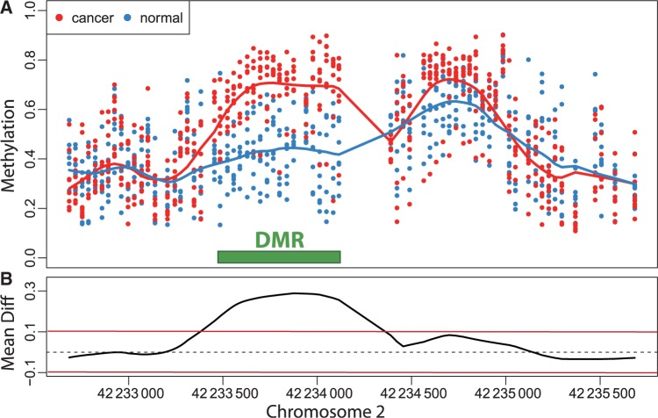
DMR methods
Algorithmic
Gathering clusters of DMLs - DSS
% significant DMLs in cluster
Significance cutoff
Distance to next CpG cutoff
Statistical
Predefined regions and sliding windows - methylKit
summarize C and T counts within region/window
Smoothing - bumphunter (array) and Bsmooth (NGS)
bumphunter

Slide 47
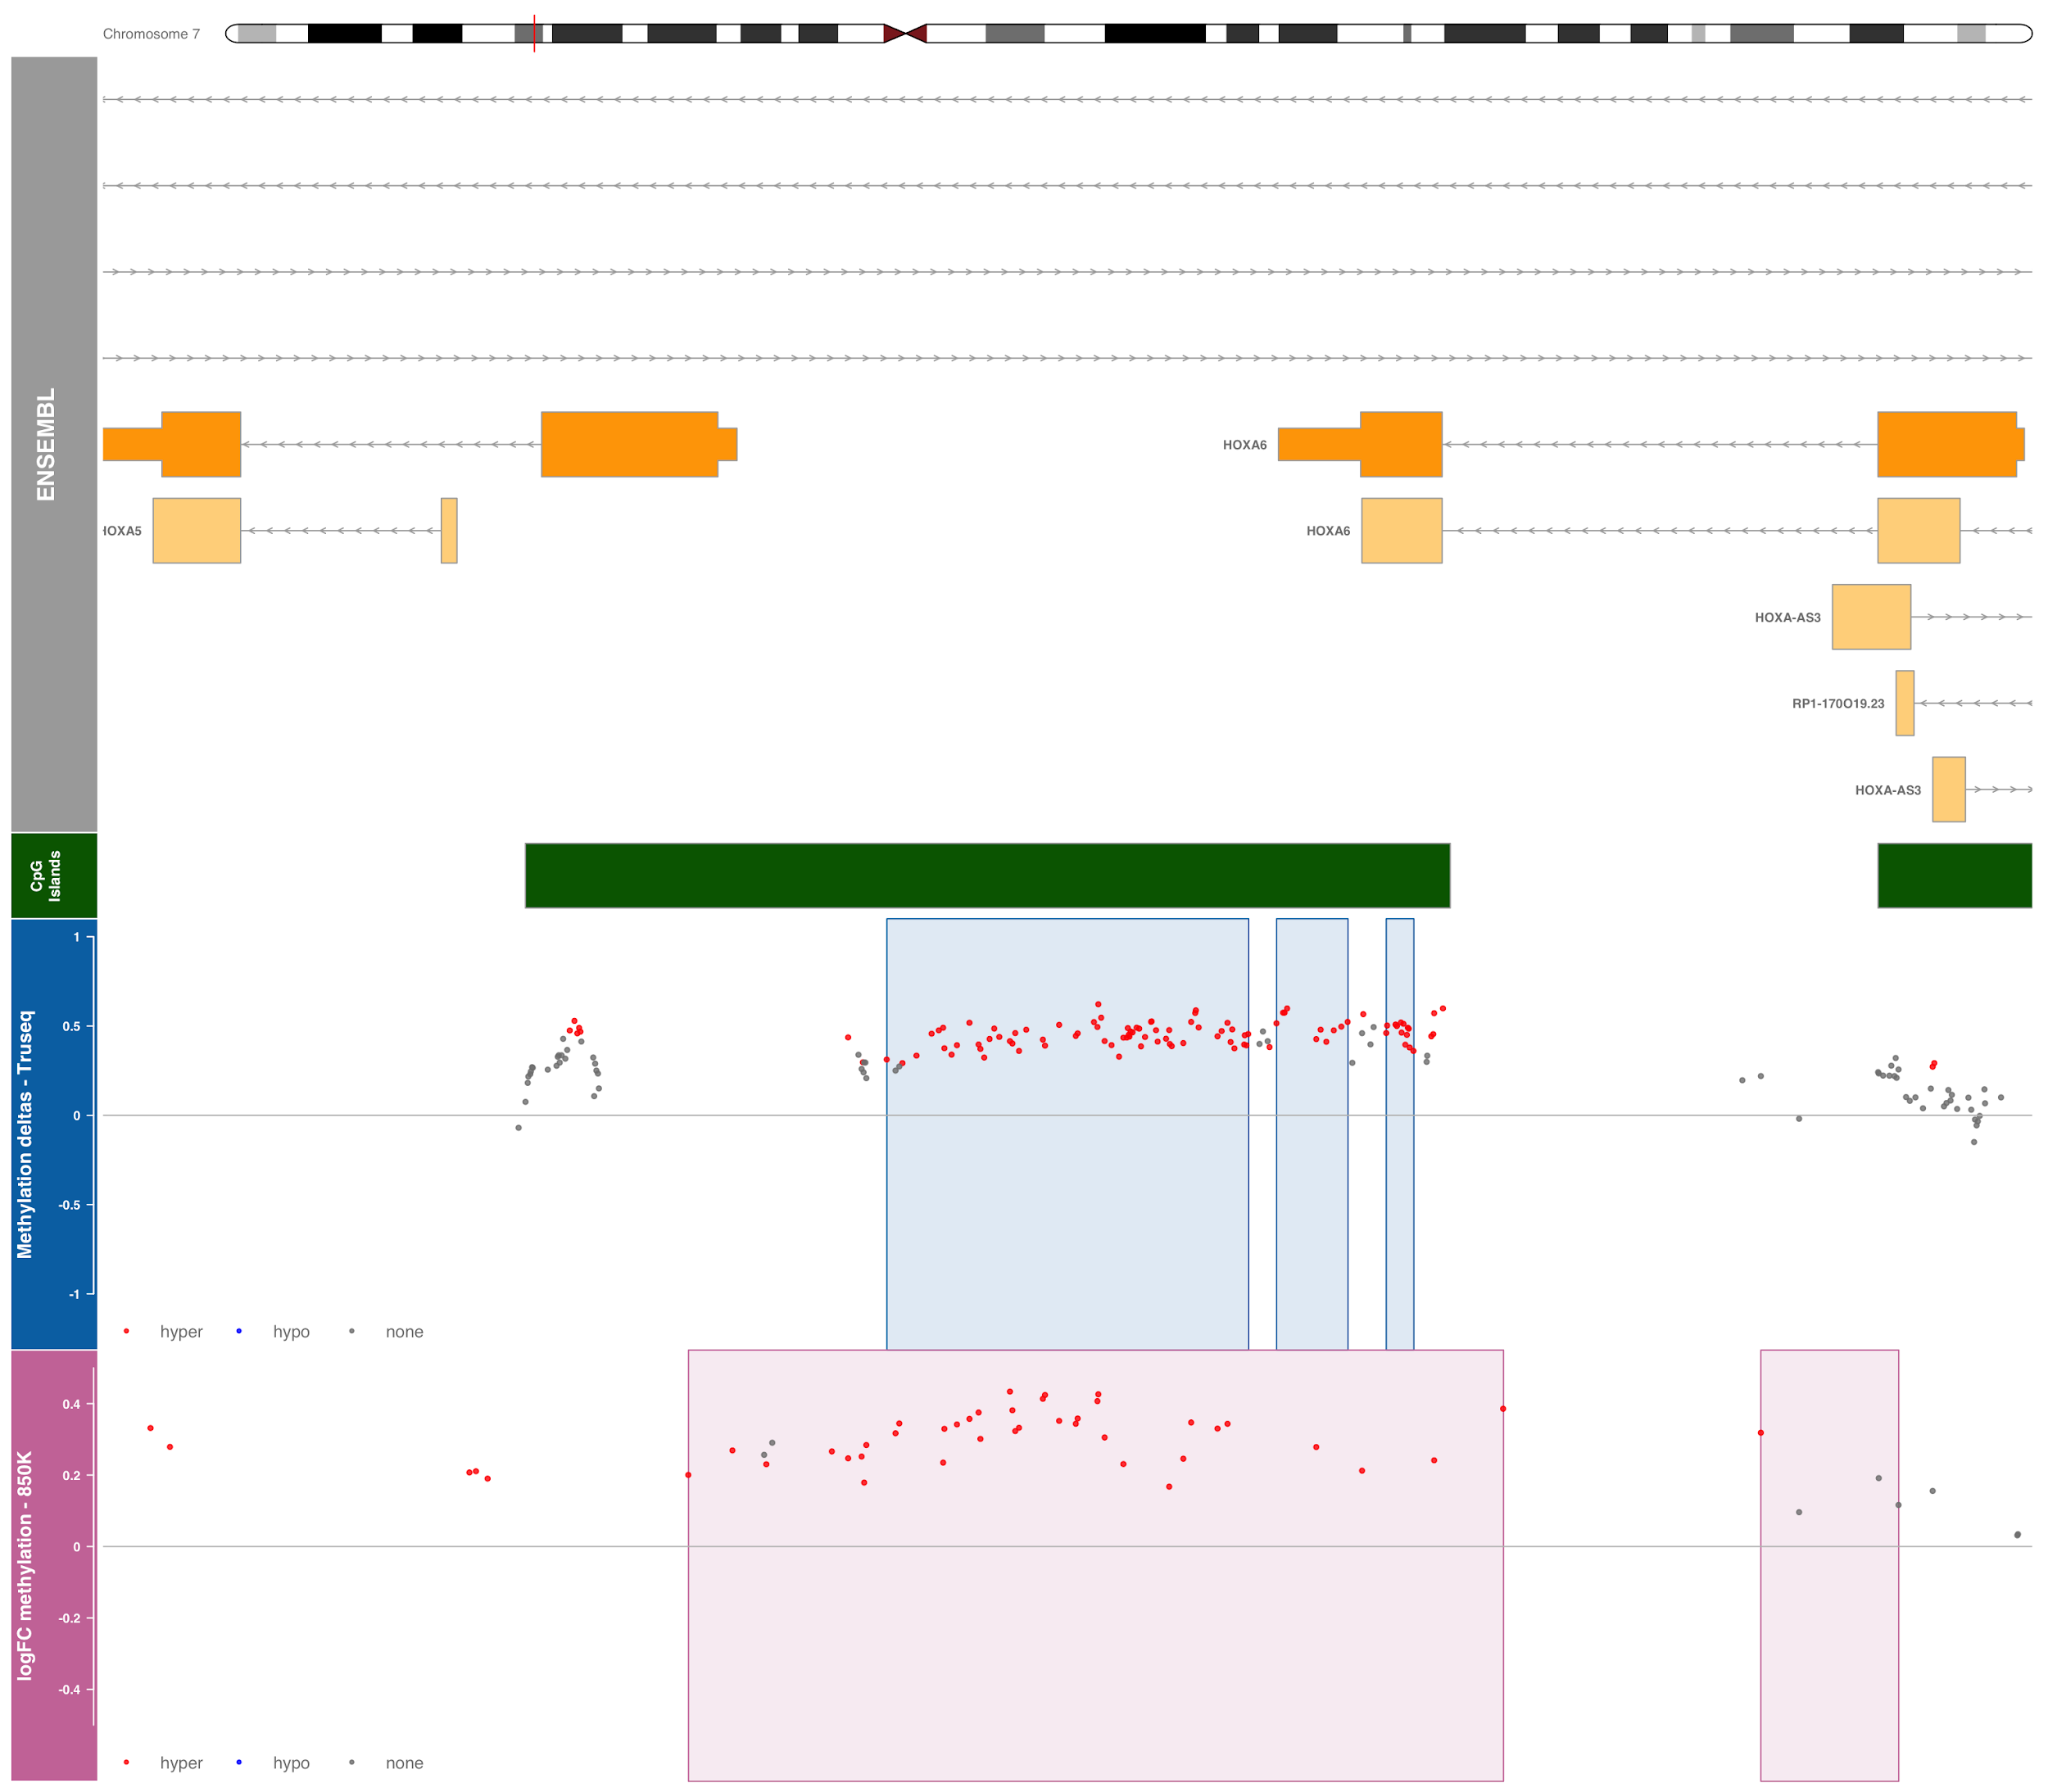
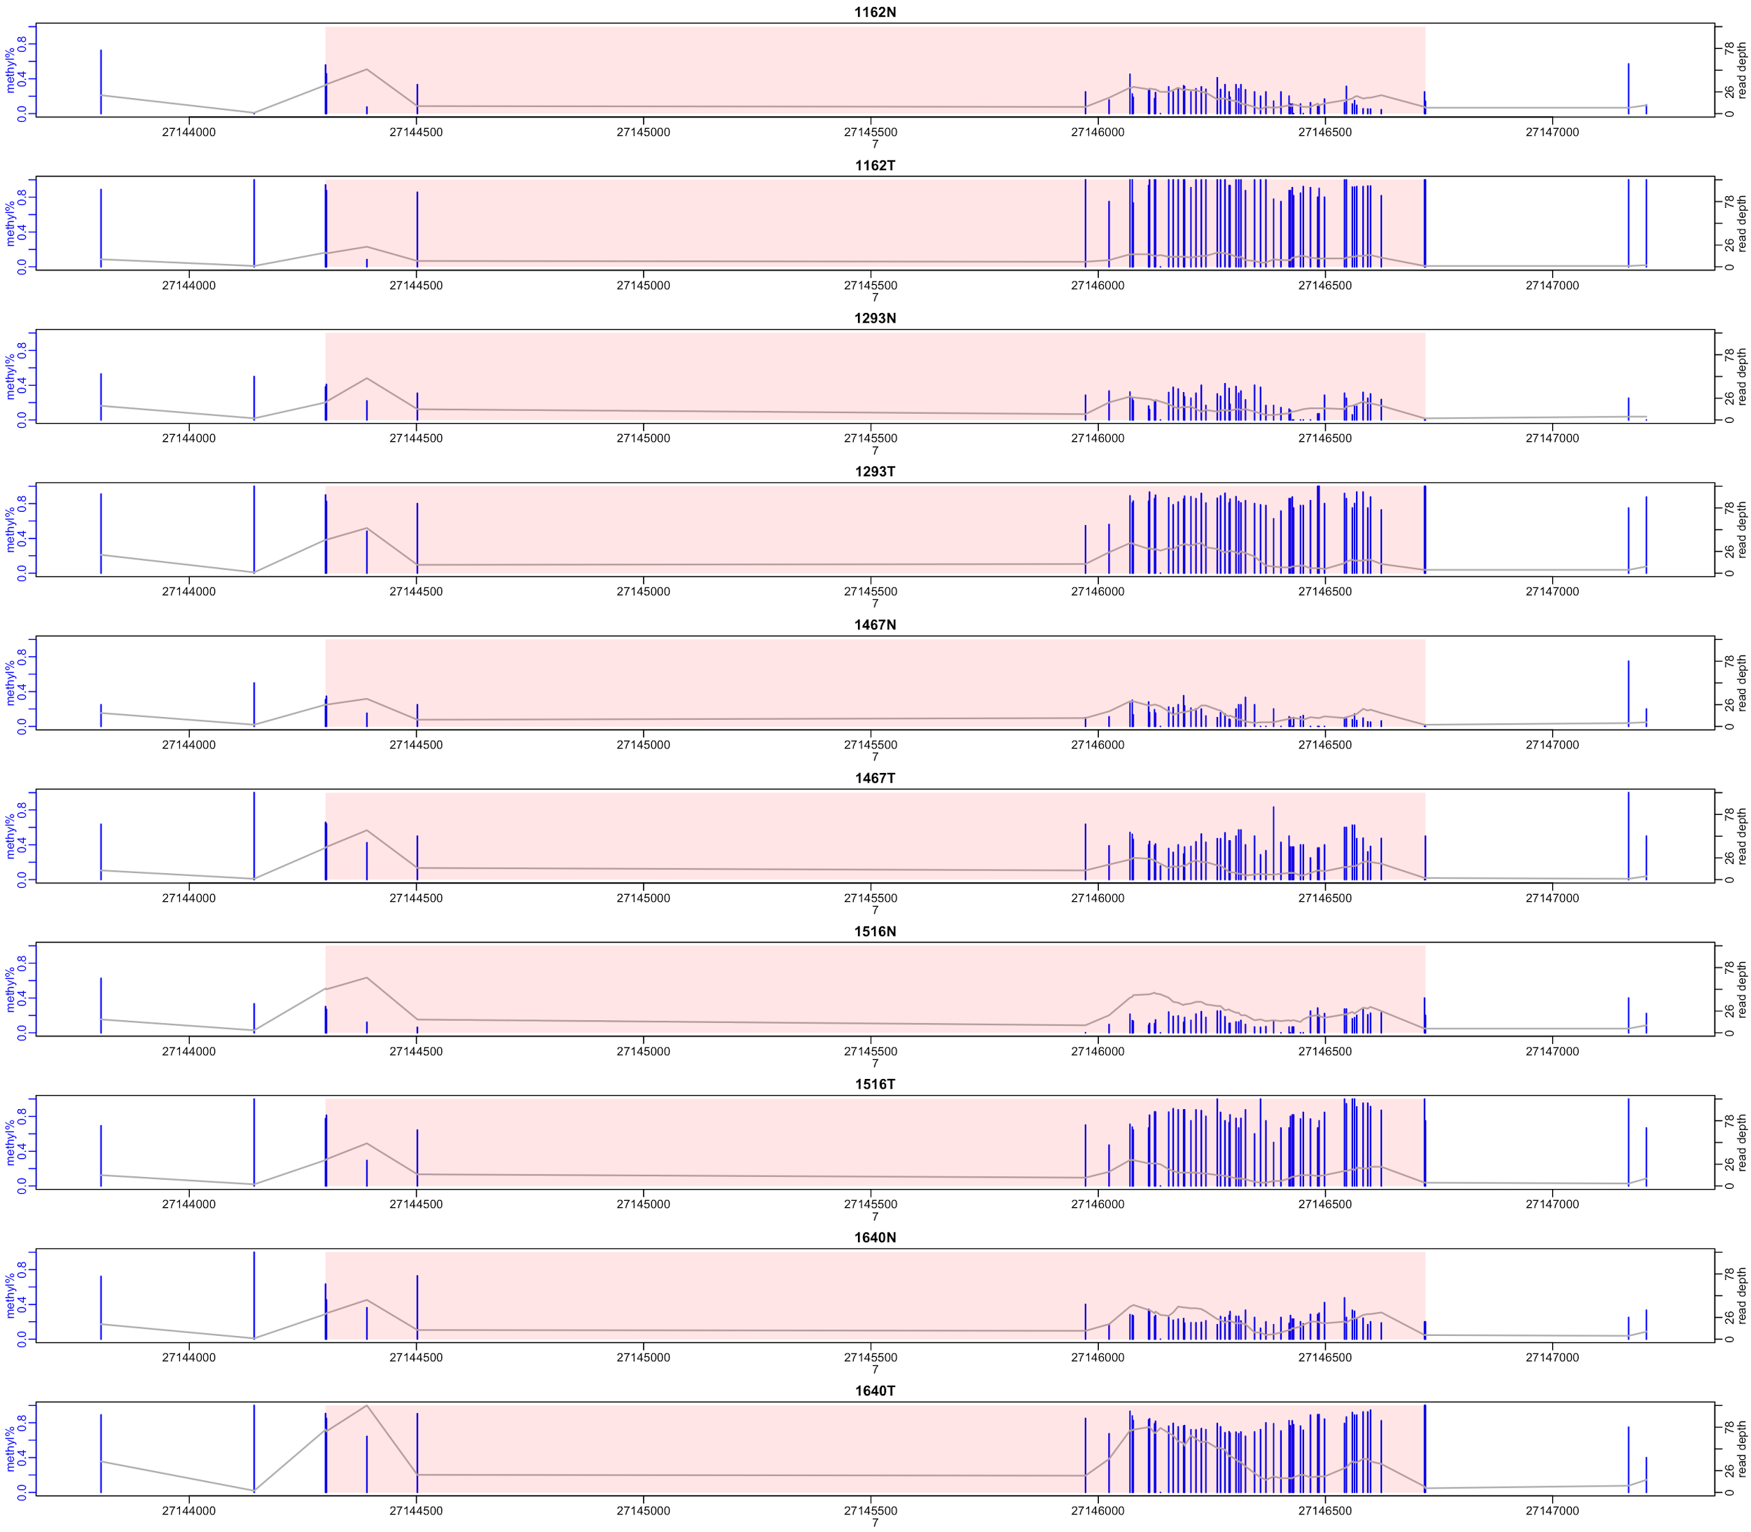
Some recent DMR results

Slide 48
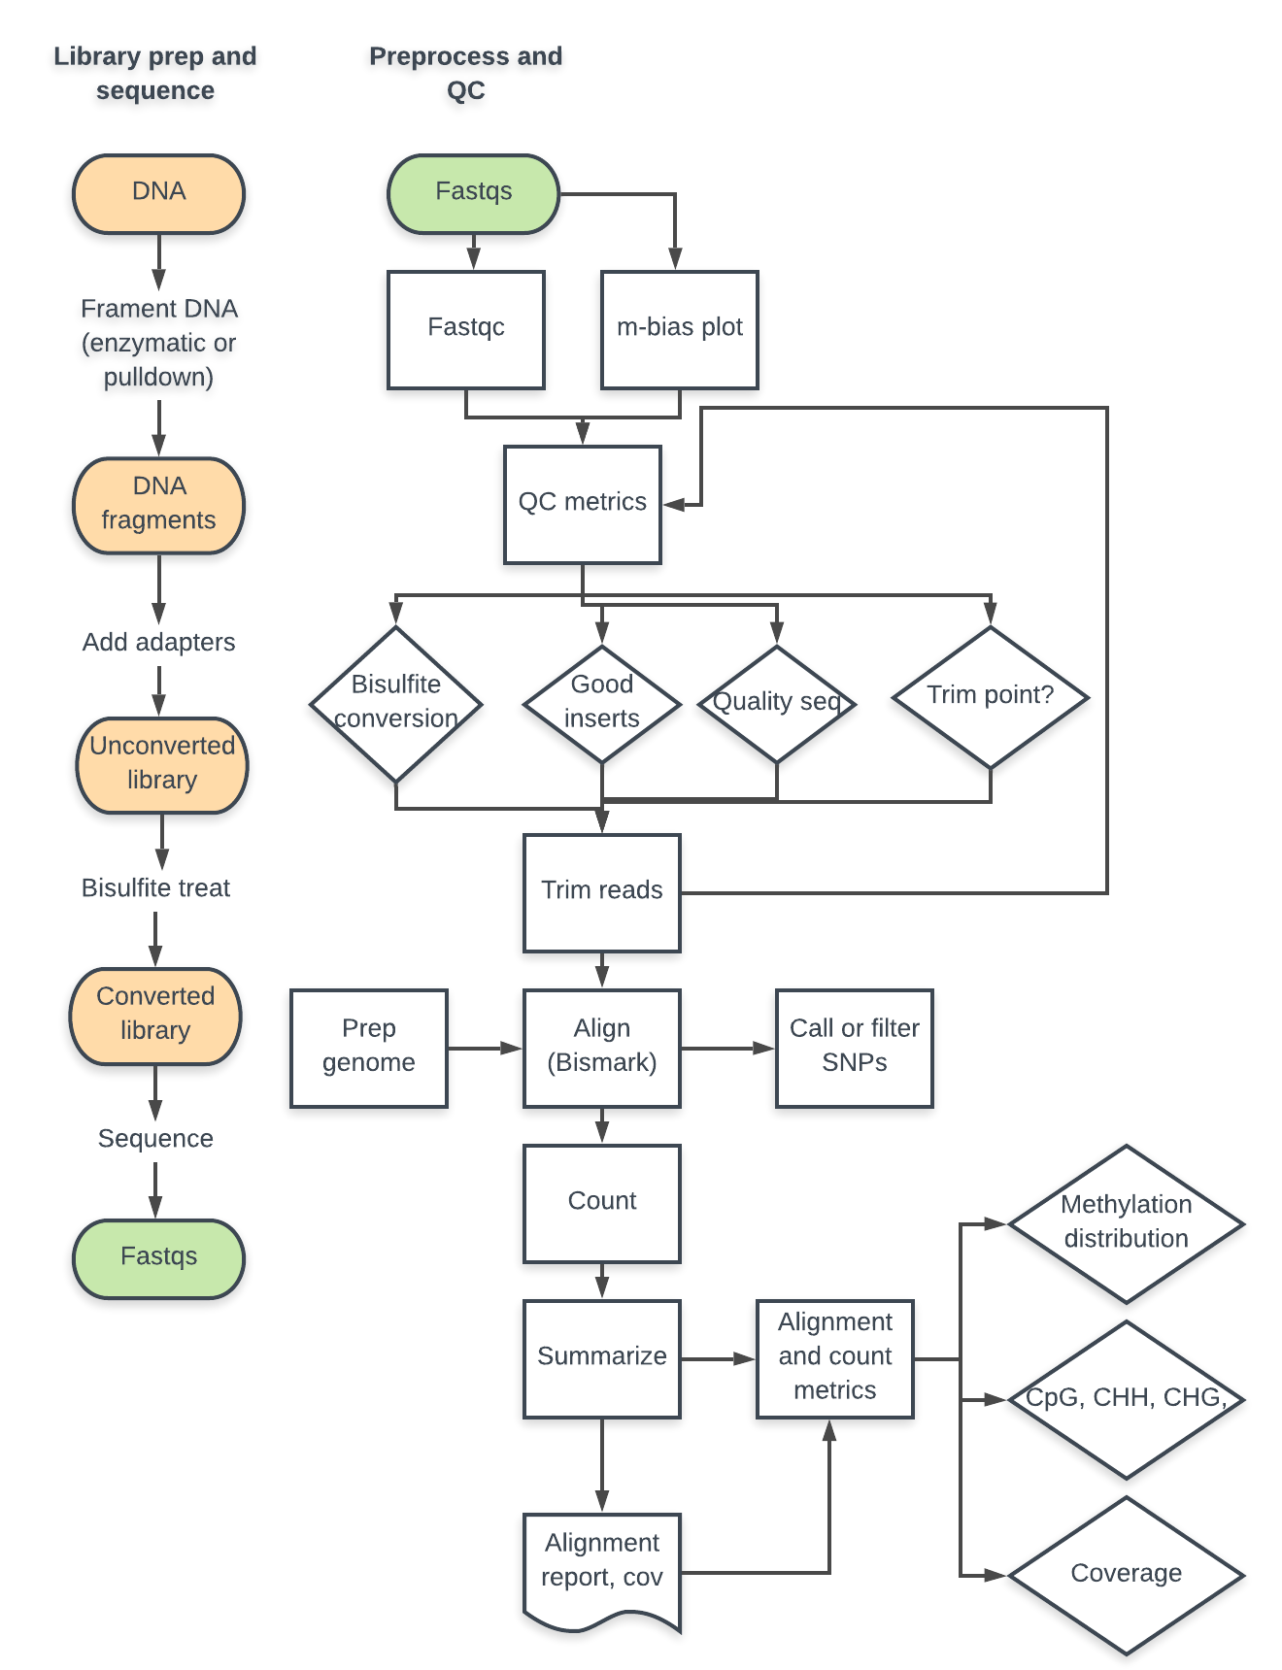

Slide 49
Annotation - Typical approaches
The issues
Goal is to map DML/DMR CpGs to biological functions
Biological functions usually encoded at the gene level
Have to relate CpG information to genes
Approaches
Closest gene
Changes to CpG islands in promoter

Slide 50
Annotation - problems
Gene size - larger genes more likely to have nearby CpG
Signal variability and integration of multiple signals
DMLs versus DMRs
What does diffuse methylation in a region mean?
Is one CpG in a region more important than another?
Predicting effect on gene expression depends on context
CpG island methylation = gene transcription off
Gene body methylation = gene transcription on
Intergenic methylation = who knows?
Formats

Slide 51
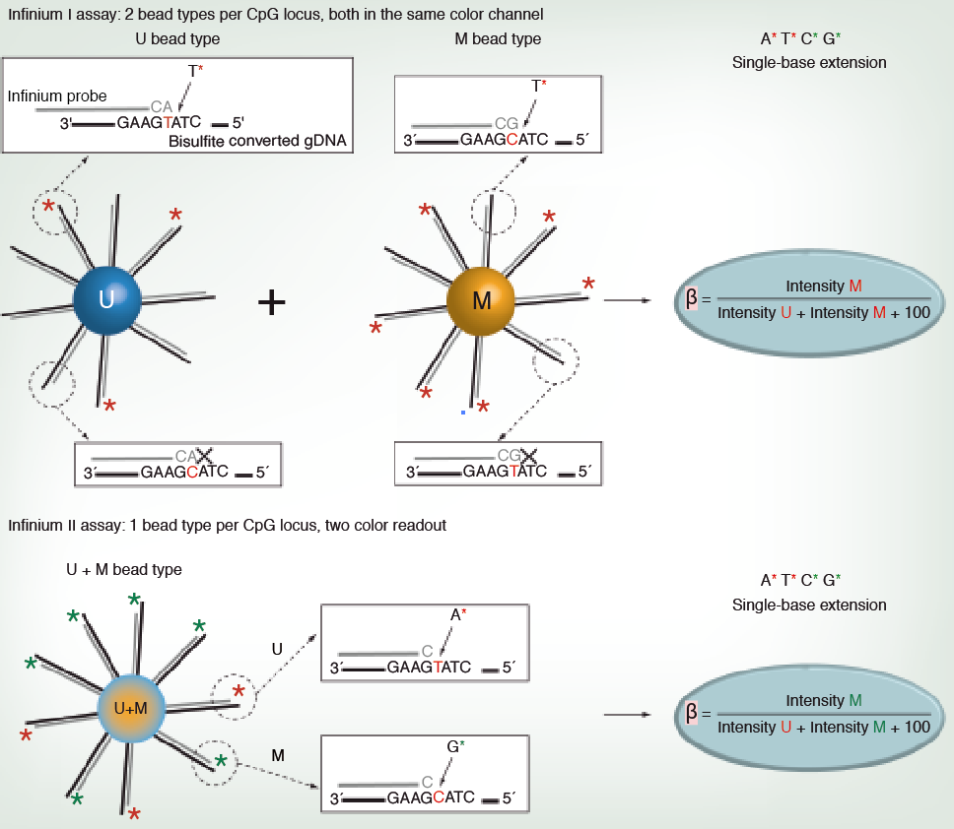
Technologies - microarray
Illumina 27K/450K/850K microarrays
Based on probe binding and extension
Two types of probes, with different distributions
Type I - 2 probes, terminate on cystosine
one probe for unmethylated, one for methylated
positive signal if can extend probe to next base
single channel
signal based on probe binding
Type II - 1 probe, terminates prior to assayed cytosine
two colors, one for unmethylated, one for methylated
Signal based on probe binding and extension
Challenging normalization
Mainly targeted to CpG islands and surrounding regions
Lots of R and Bioconductor support
HUMAN ONLY

Slide 52
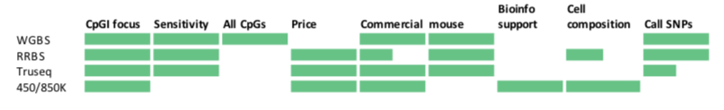

Slide 53
Bisulfite methods
Whole genome bisulfite sequencing
Large files (120GB)
Recommended 30 X coverage across all samples
Targeted methods
Target CpG islands and other areas of interest
Enzymatic digestion based - Reduced Representation Bisulfite sequencing (RRBS) (3-5GB)
Capture based - Illumina TruSeq Methyl Capture EPIC (~15GB)

Slide 54
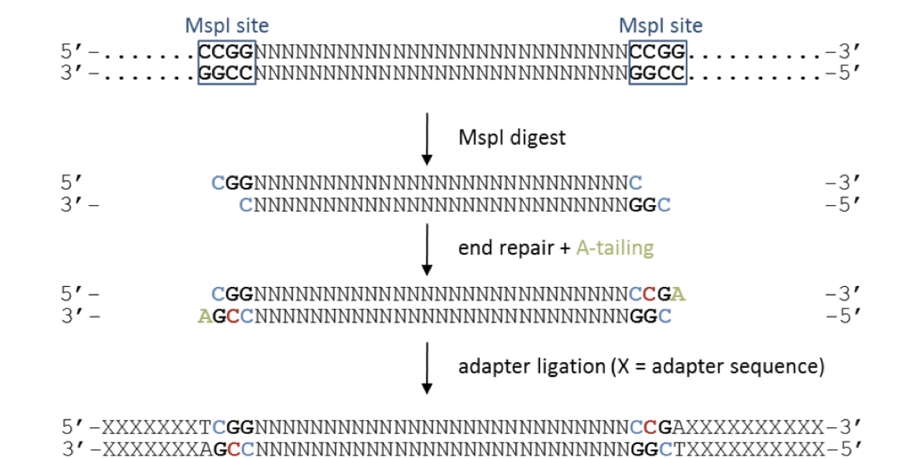
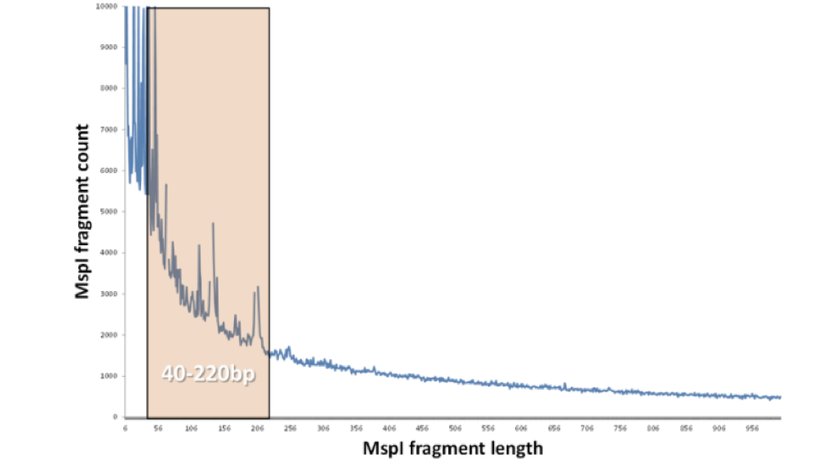
RRBS - Reduced Representation Bisulfite Sequencing
Single end (common) or paired end
low diversity

Slide 55
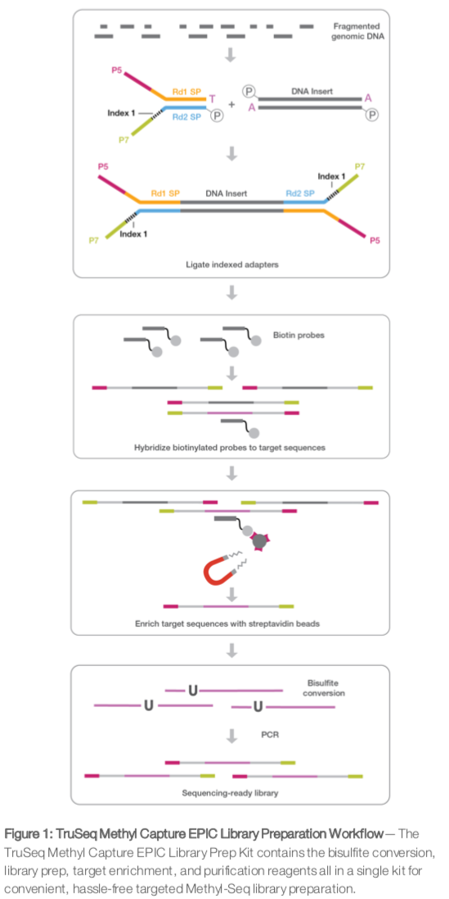
Illumina Truseq EPIC Methyl Capture
Paired end sequencing
Recommended 55 million reads = mean coverage >40X, max CpGs with >10X

Slide 56
CpG islands - definition and some facts
length greater than 200bp
G+C content greater than 50%
a ratio of observed to expected CpG greater than 0.6
Major regulatory units
Methylation of CpG islands in promoters represses transcription
90% are constitutively unmethylated, enriched for H3K4 methylation
methylated CpG Islands are often intergenic or intragenic
60-75% of genes have them in their promoters

Slide 57
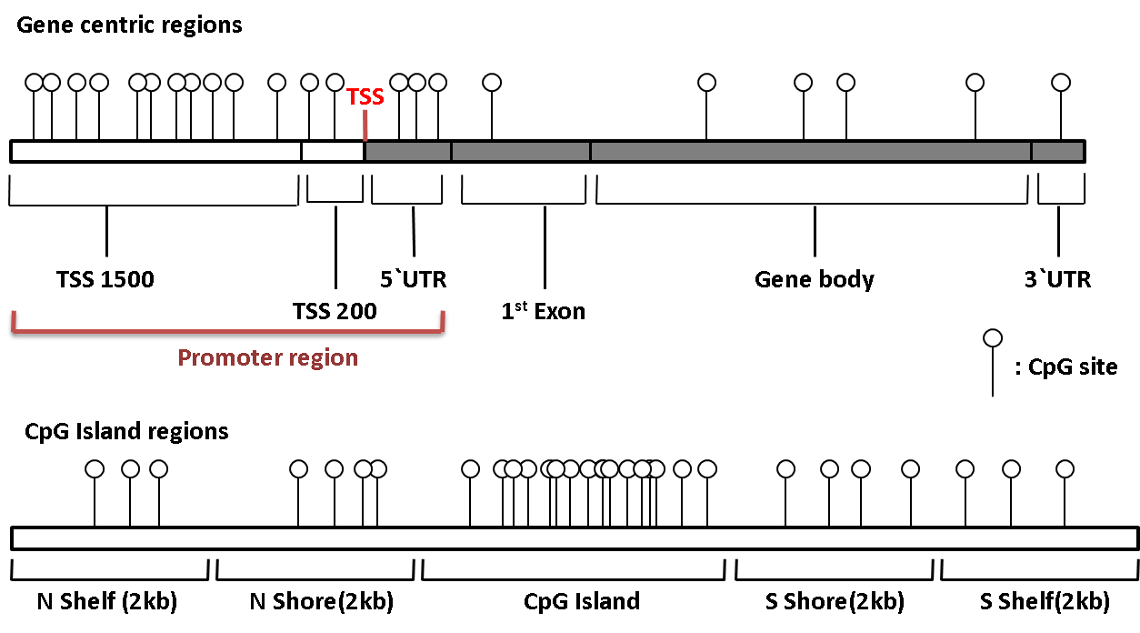

CpG islands - genomic structure
Open sea
Open sea
shores show variable tissue-specific DNA methylation patterns often altered in tumorigenesis

Slide 58
Alignment questions and issues
Strand sequenced?
Capture methods may only capture one strand before bisulfite conversion
Directional versus non-directional libraries?
Directional - only OT and OB post-bisulfite PCR strands sequenced
Non-directional - all 4 possible strands sequenced (OT, CTOT, OB, CTOB)
Typically only see directional, but Bismark has output to determine which it is
Paired versus single end
Typically no reason to do paired end with RRBS or Truseq
Align to full genome or to partial genome?
Whole genome = conservative approach as pulldowns and digests are not perfect
Reduced genome = better mapping percentages, but are they real? Found ~8% off target alignment with Truseq methyl capture method
What about duplicate reads?
Depends on application
Reduced representation - don’t dedupe, assayed regions too small
Whole genome - dedupe

Slide 59
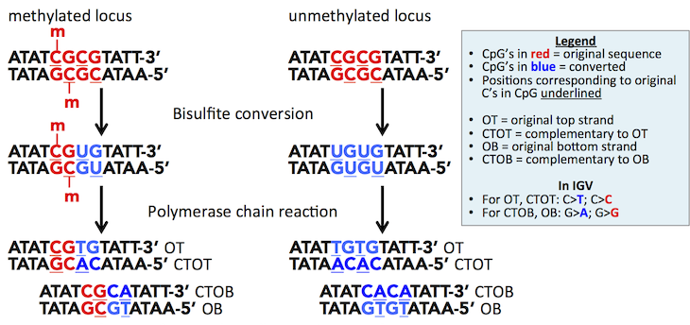
Alignment

Slide 60
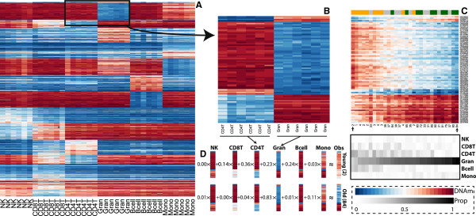
Cell composition
Changes in DNA methylation may actually reflect changes in cellular composition, especially in blood
Need to adjust for cellular composition effects
Established methods to quantitate and adjust for cell composition effects exist for arrays
Adapted but not established methods exist for RRBS
For Truseq and WGBS, can only adjust (using SVA)
Notes:
B - probes definiting CD4T and granulocyte cells
C- heatmap for multiple aged samples for probes from B, ordered by estimated granulocyte percentage
D- can reconstruct patterns of the two sample note by arrows in C using weighted averages of cell specific probes

Slide 61
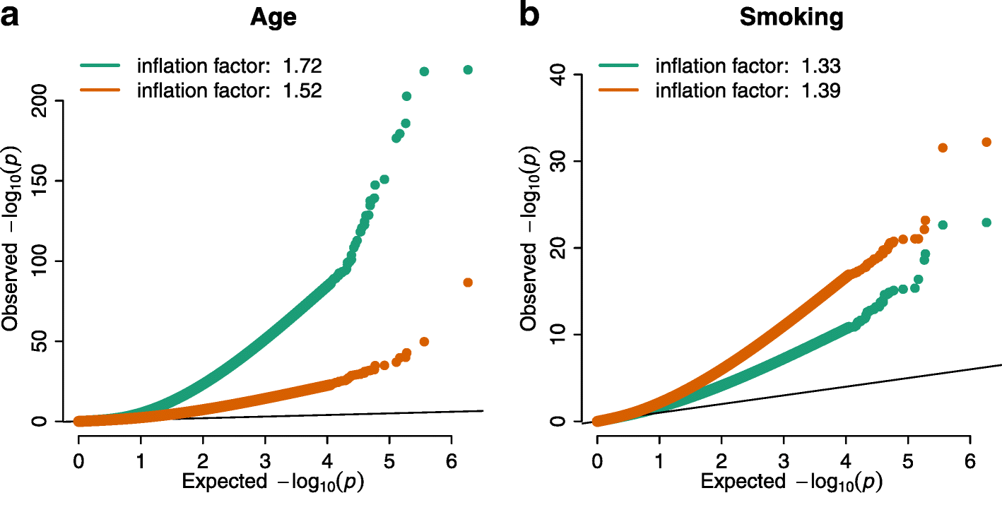
Genomic inflation
Population structure and hidden factors (eg SNPs and cell composition effects) can massively inflate pvalues
Genomic methods not appropriate as assumption of few real effects is broken

Slide 62
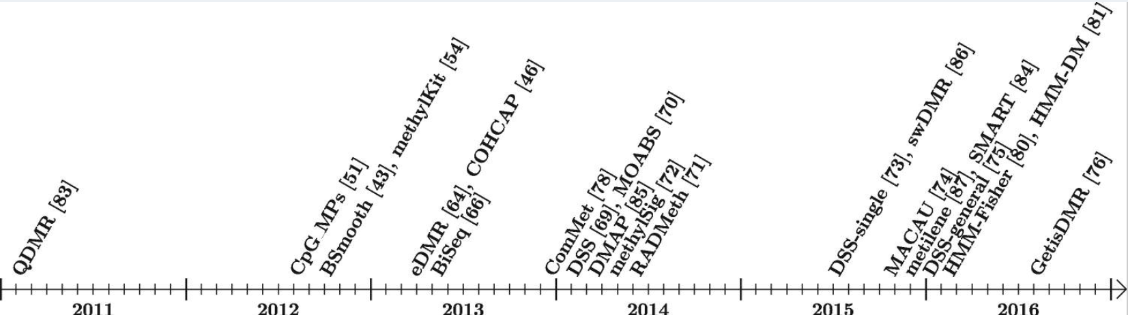
Statistical models for differential methylation
Goal
find differences in C/T ratios at loci
Incorporate read number variation (i.e. coverage variation) for both assays
Incorporate replicates
General Methods
Fisher’s exact test - does not account for replicates or variation
Regression - logistic (MethylKit), beta after smoothing (BiSeq)
Beta-binomial model (MOABS, DSS, MethylSig)
can account for both sampling and epigenetic variability
Bayesian, hierarchical (DSS)
Packages
BiSeq, MOABS, MethylSig, DSS, RADMeth, MLML

